Slide 1
Addressing The Use of AI in Academic Settings
Atiq, Hannah Cuff, Harshika Shrestha, Mo

Slide 2
Enhancing Faculty Awareness of AI
01

Slide 3
AI Limitations ≠ Dismissal
All existing AI apps ‘hallucinate’ and supply false information; don’t rely on AI for accurate information, but always fact-check.
- Betsy Leondar-Wright, Lasell University
If you choose to use generative AI tools, remember that they are typically trained on limited datasets that may be out of date. What's more, they may hallucinate -- that is to say, they may present output that contains incorrect information, falsehoods, and biases.
- Emily Isaacs, Montclair State University
Syllabi Policies for AI Generative Tools.
https://docs.google.com/document/d/1RMVwzjc1o0Mi8Blw_-JUTcXv02b2WRH86vw7mi16W3U/preview?tab=t.0
Notes:
There’s a lot of confusion around artificial intelligence—what it is, when to use it, and how to use it effectively. It’s true that AI systems work by recognizing patterns to ‘understand’ and respond to prompts. However, labeling them as either entirely unreliable or completely false oversimplifies their functionality. AI isn’t inherently good or bad—it’s a tool. Its effectiveness depends on how it’s used and by whom. For example, in our own project, we used NotebookLM to synthesize information from multiple sources, allowing us to quickly identify similarities, differences, and relevant data. This shows how AI can enhance learning when used responsibly.
We must embrace AI as a legitimate tool in the classroom. Schools should prioritize teaching students to use AI responsibly, ethically, and effectively. To achieve this, professors can design assignments that incorporate AI tools, showing students their benefits as well as educate students on AI through in-class discussions. Not acknowledging and accepting AI’s potential and it’s limitations doesn’t prepare students for a tech-driven world.

Slide 4
Vagueness of AI Policies
Submitting work containing any content generated by artificial intelligence (AI) when not explicitly directed to do so by the instructor will be considered an act of academic dishonesty.
- Elizabeth Vincelette, Old Dominion University
Syllabi Policies for AI Generative Tools.
https://docs.google.com/document/d/1RMVwzjc1o0Mi8Blw_-JUTcXv02b2WRH86vw7mi16W3U/preview?tab=t.0
Notes:
At first glance, this syllabus seems straightforward, and many similar policies exist at Trinity. However, vague AI guidelines leave students with unanswered questions: What exactly qualifies as 'content generated by AI'? Does this include tools like Grammarly? What about using AI to brainstorm or organize ideas without directly copying its outputs?
Vague policies leave students in a gray area, increasing the risk of accidental plagiarism. This confusion means a well-intentioned student could find themselves facing serious consequences for behavior they believed was within the rules. Students want transparency and guidance. Institutions must create policies that explicitly define acceptable AI use and provide clear boundaries.
To achieve this, institutions should:
Clearly define and share examples of acceptable and unacceptable AI use.
Require students to acknowledge and explain their use of AI tools.
Update policies as AI technology evolves to ensure they remain clear and relevant.
By implementing these steps, institutions can maintain academic integrity while acknowledging the usefulness of AI.

Slide 5
No college-wide AI Policy
Lack of a coherent and unified policy can result to inconsistency and equity concerns.
Varying policies across courses results to confusion
Existing AI policies are broad and lack clarity (Cryer, 2024).
No clear AI policies leaves loophole and results to mistrust (Terry, 2023).
Source

Slide 6
Issues
Unclear boundaries: Policies ranging from strict prohibition to complete acceptance (Cryer 2024).
Struggle to define academic dishonesty and misuse?
Unintentional Plagiarism and its consequences!
Enforcement challenges.
EDUC 200- Dr. Teresa Speciale

Slide 7
Moving forward
The need for comprehensive and well-defined policies covering various use of AI (Gardner, 2024).
Clear communication to prevent misunderstanding and confusion
AI literacy

Slide 8
AI Detectors in Academia
02

Slide 9
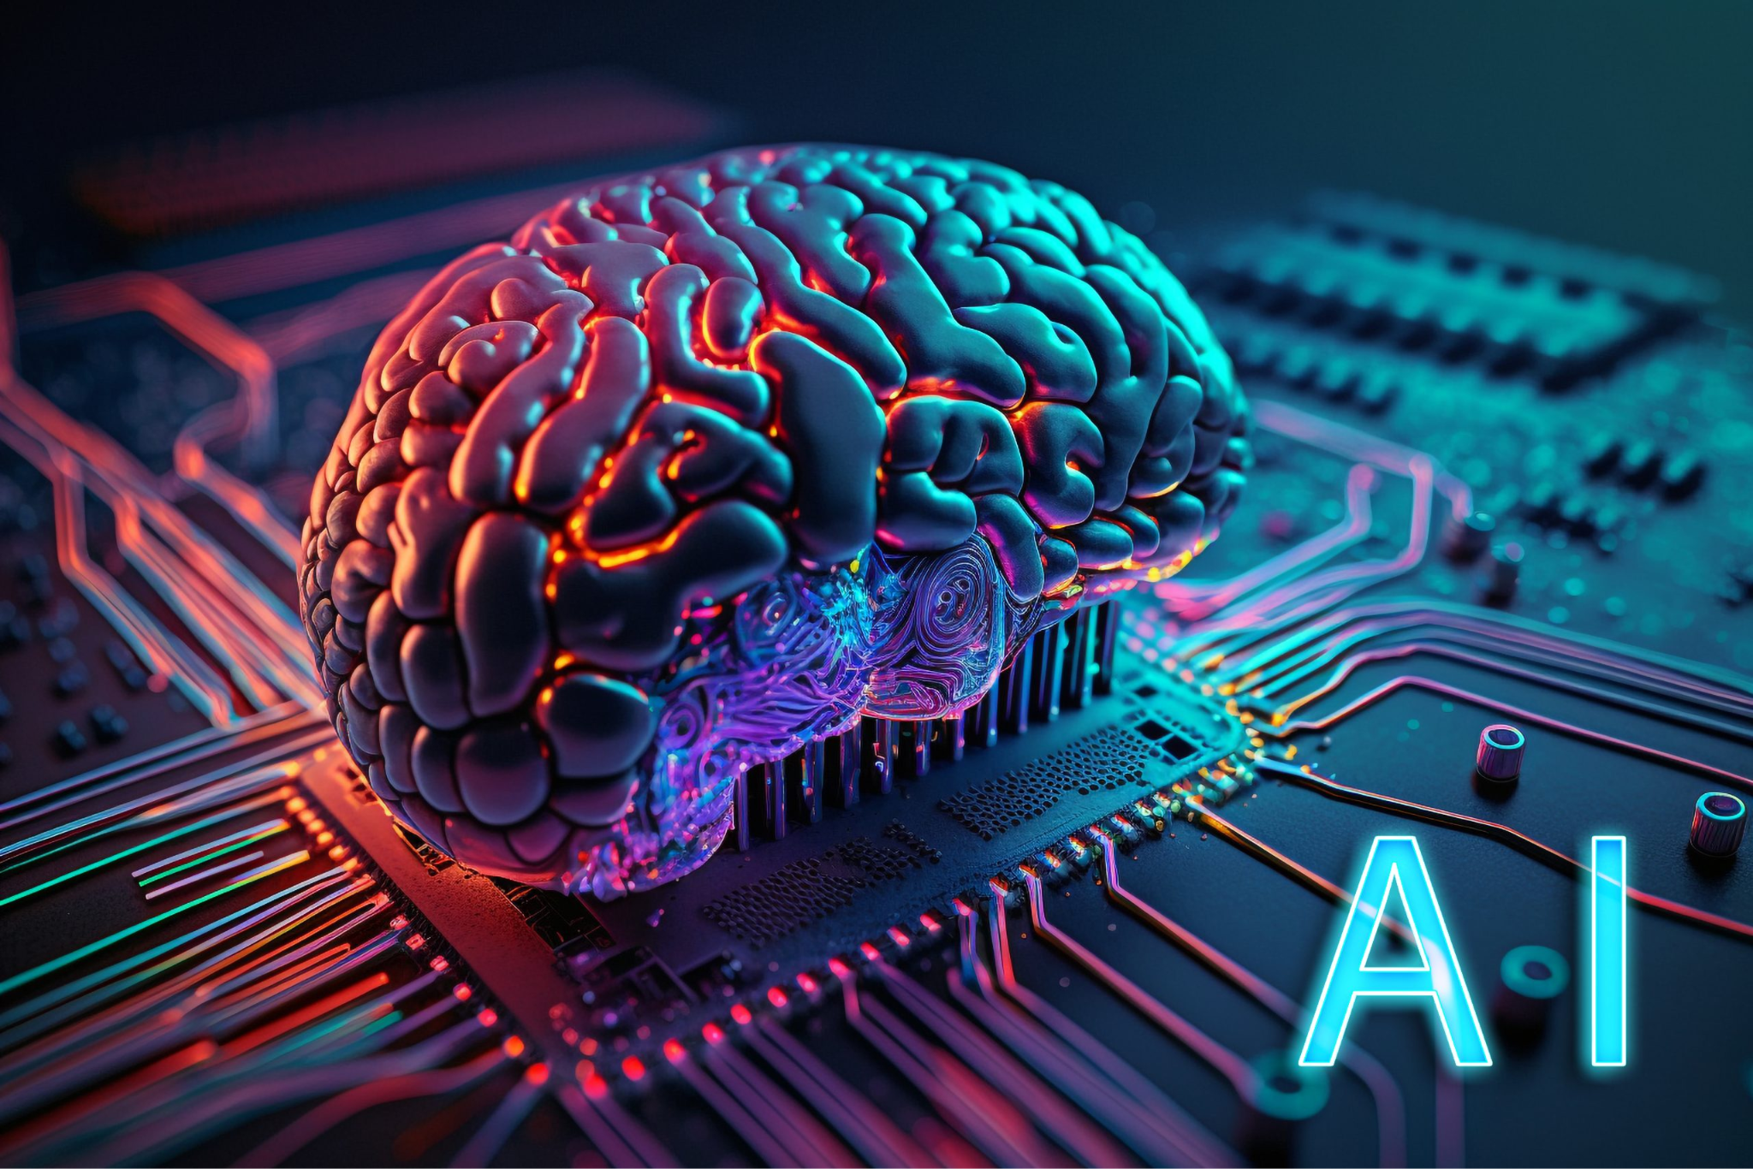
AI Detection Tools Are Not Reliable
Image from google image

Slide 10
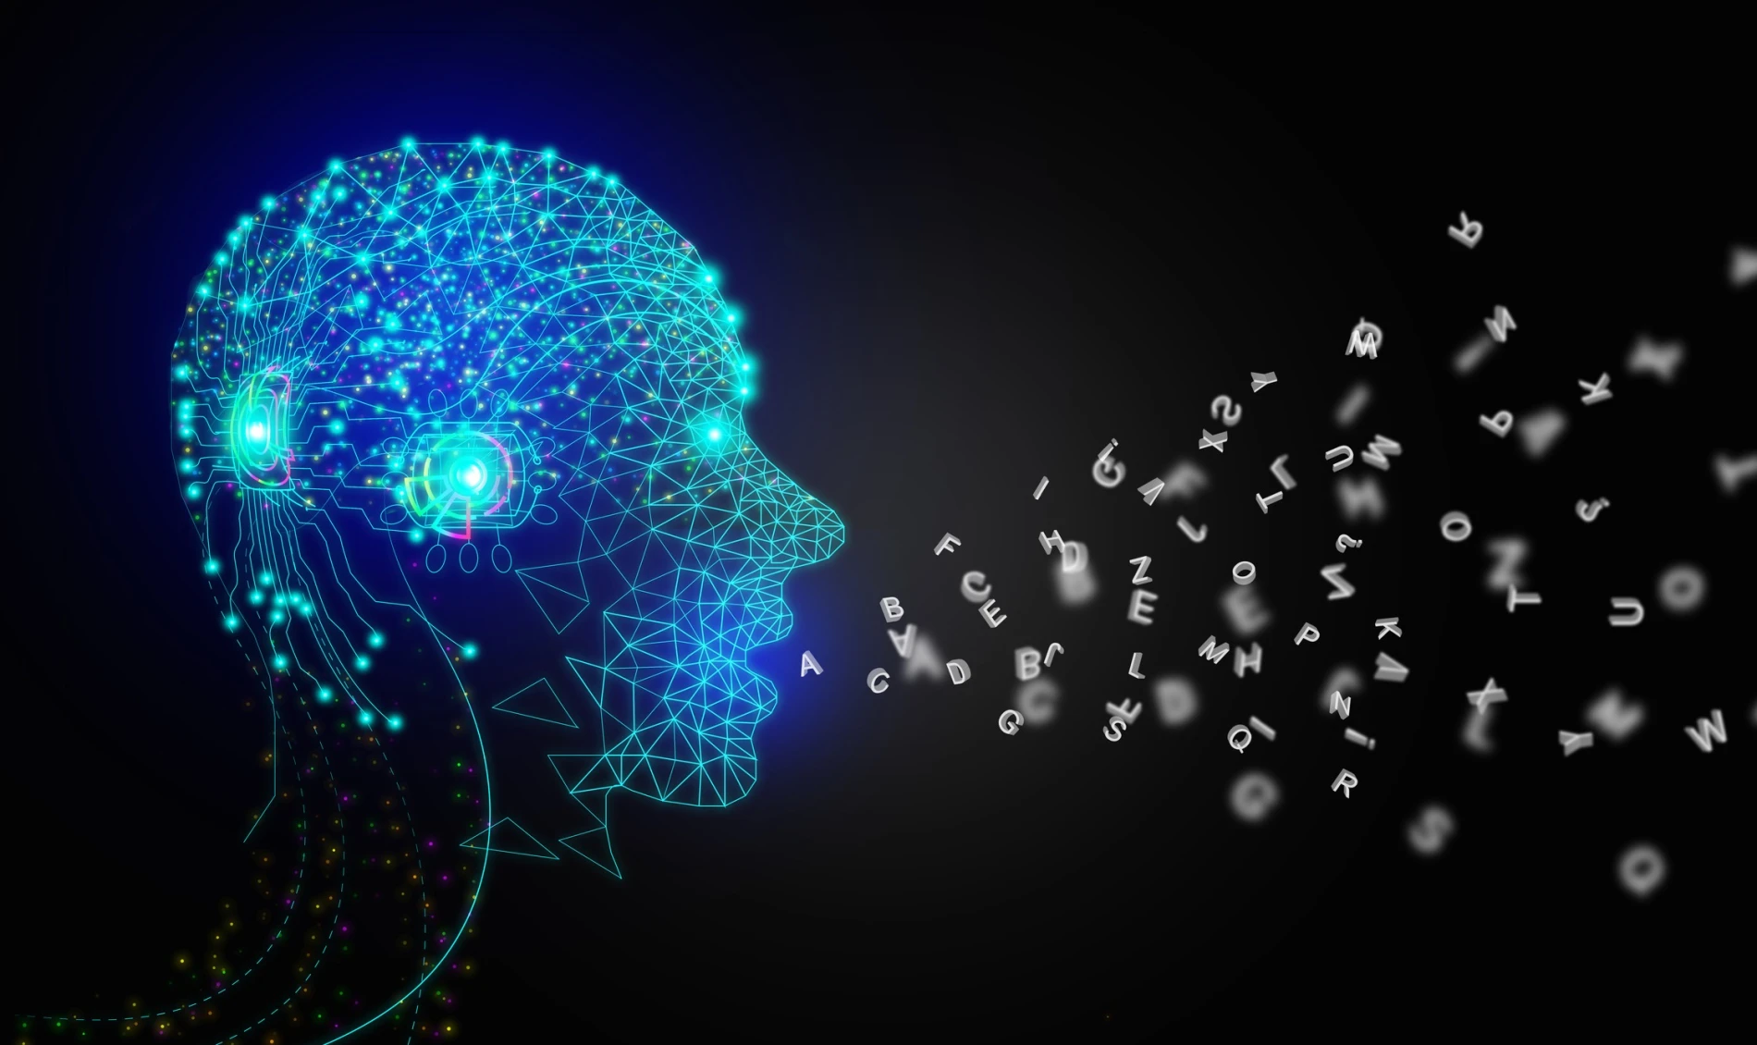
AI Detectors= AI
Image from google image

Slide 11
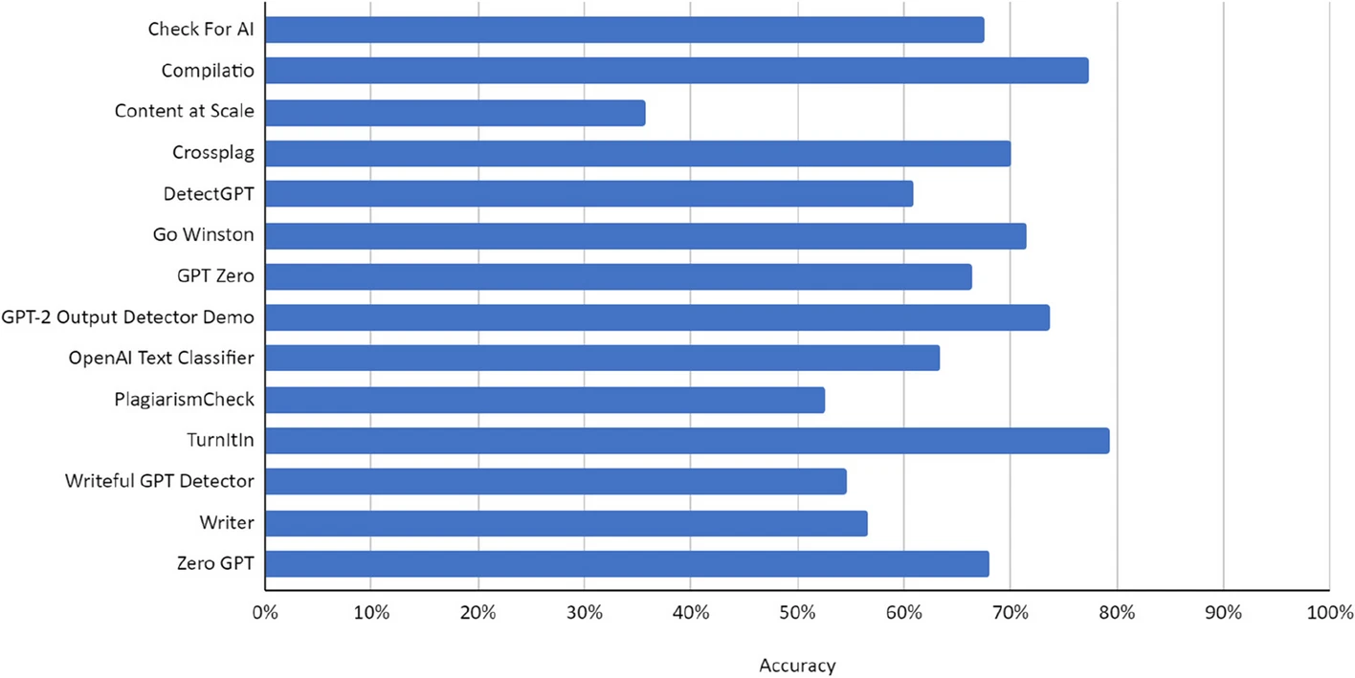
Wide Variability in Performance
(Weber-Wulff et al., 2023)

Slide 12
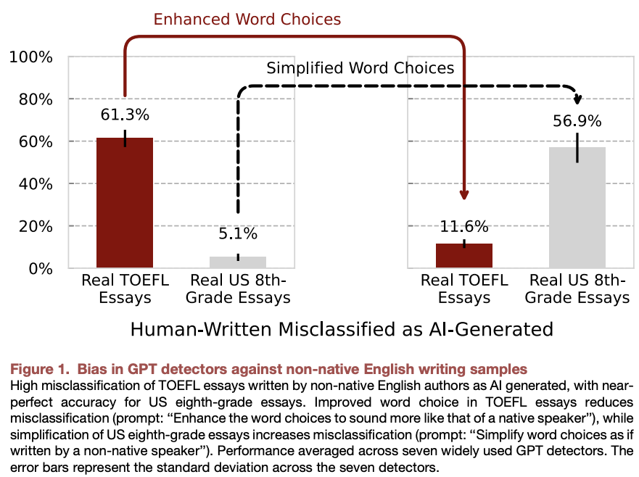
Bias Against Non-Native Writers
Emphasis on Text Perplexity
(Liang et al., 2023)

Slide 13
Susceptibility To Manipulation
Image from google image

Slide 14
AI detection tools are prone to being tricked
Including spelling mistakes (Perkins et al., 2024)
Carefully written prompts
Prompting AI to mimic a writer’s voice

Slide 15
AI Technology Is Rapidly Evolving
AI detectors cannot keep up with the latest versions and updates of AI technology designed to mimic humans.

Slide 16
Impact of AI detectors
Non-accurate results
False positive increase
Harm towards non-native writers
5 out of 14 were 50% accurate or worse (Bowens and Watson, 2024)
Turnitin false-positive increased from 1% to 4% at the fall of 2023 (Bowens and Watson, 2024)
false-positive rate averaged 61.3% for non-native english speaker(Liang-et-al, 2023)
Follow the link in the graph to modify its data and then paste the new one here. For more info, click here

Slide 17
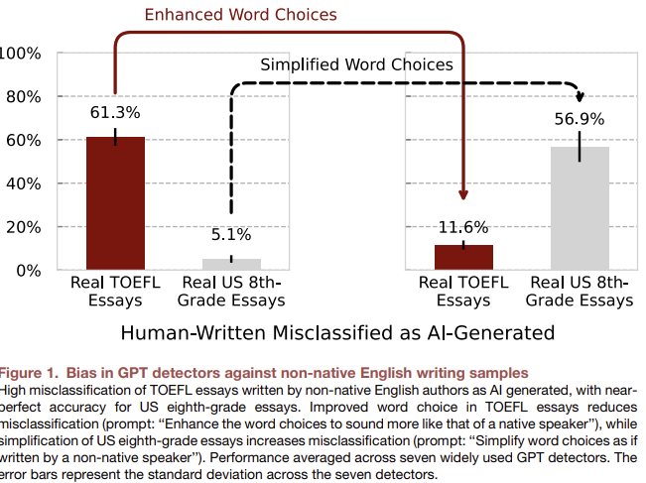
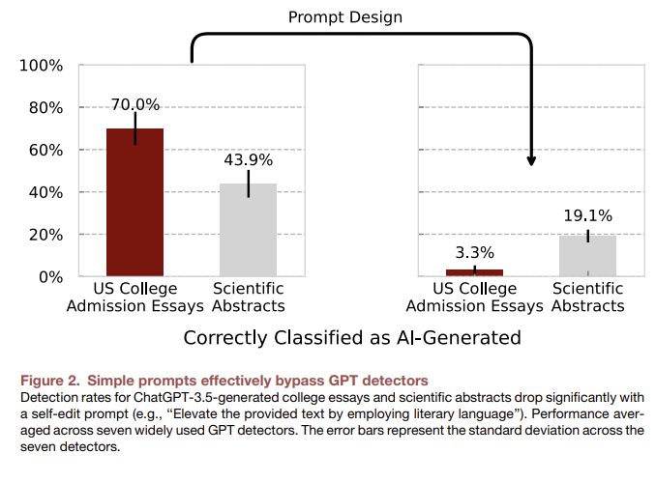
AI Detectors Don’t matter
Liang, W., Yuksekgonul, M., Mao, Y., Wu, E., & Zou, J. (2023). GPT detectors are biased against non-native English writers. Patterns, 4(7).

Slide 18
Syllabus Examples

Slide 19
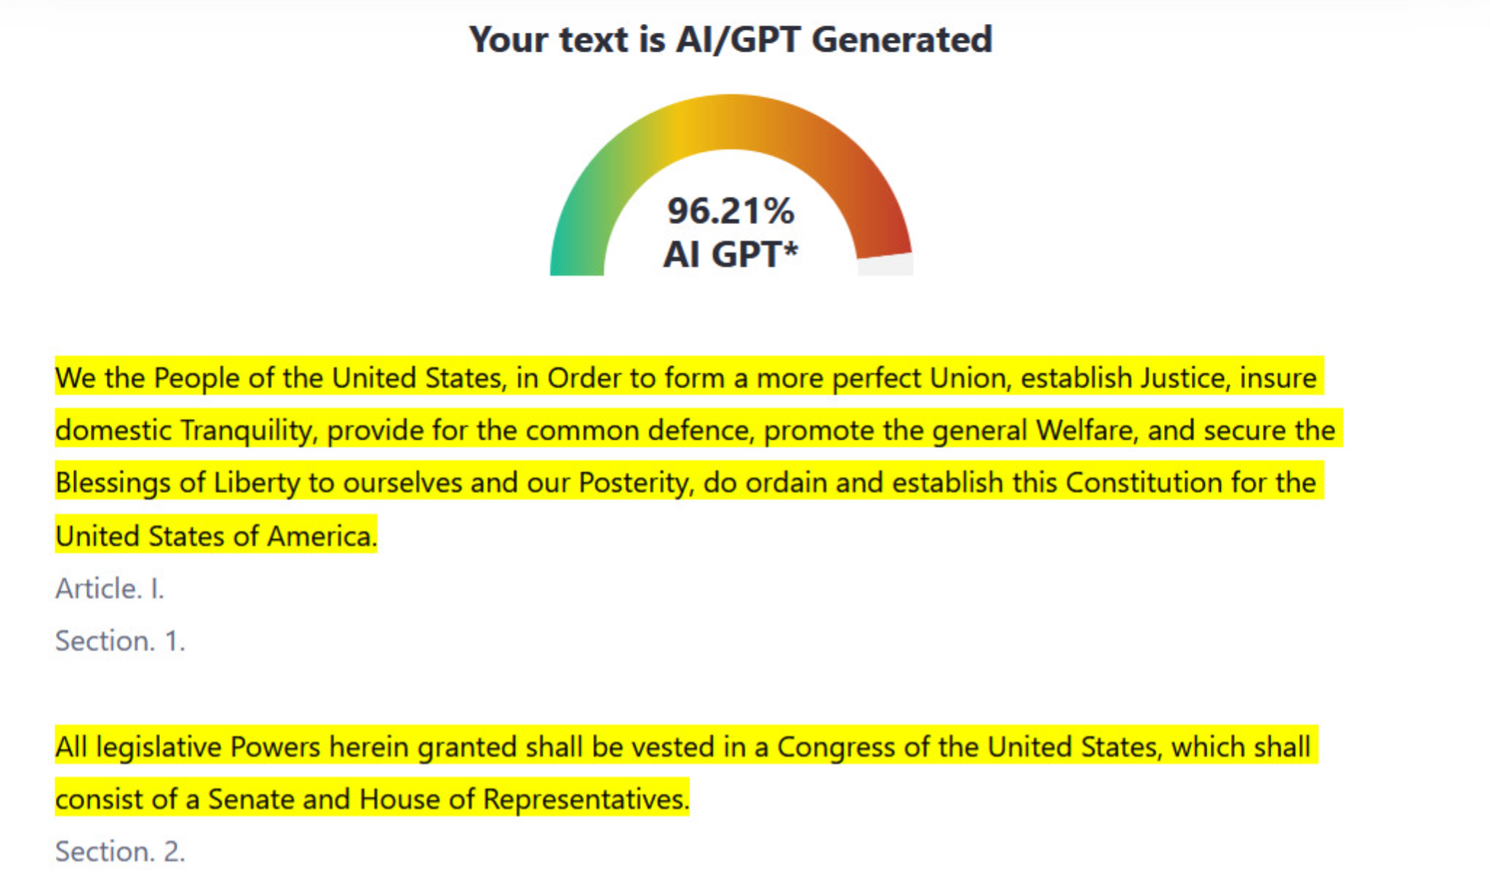
(Edwards, 2023)

Slide 20
What can professors do?
Design truly engaging assignments with components of knowledge application, community engagement, and self-reflection
Scaffolded assignments with maximum relevance to real-world scenarios
(Sotiriadou et al., 2020)
“Assign tasks where students critique the reliability of AI output”
(Trinity College)

Slide 21
What can we do
Don’t rely on AI detection tools
Actively foster a community in class built on trust and mission of learning
Focus on work that is subjective and not AI applicable
Integrate more engaging for credit activities in class.

Slide 22
Bibliography
Bowen, J. A., & Watson, E. (2024, May 2). AI detection is a business. But should it be faculty business?. The Chronicle of Higher Education. https://www.chronicle.com/article/ai-detection-is-a-business-but-should-it-be-faculty-business
Edwards, B. (2023, July 14). Why AI writing detectors don’t work. Ars Technica. https://arstechnica.com/information-technology/2023/07/why-ai-detectors-think-the-us-constitution-was-written-by-ai/
Elkhatat, A. M., Elsaid,K., & Almeer, S. (2023). Evaluating the efficacy of AI content detection tools in differentiating between human and AI-generated text. International Journal for Educational Integrity, 19(1), 17.
Illinois State University. (2025, January 13). Why Don’t AI Detectors Work? Center for Integrated Professional Development . https://prodev.illinoisstate.edu/ai/detectors/
Leechuy, J. (2024, March 14). How reliable are AI detectors? claims vs. reality. The Blogsmith. https://www.theblogsmith.com/blog/how-reliable-are-ai-detectors/#:~:text=likely%20AI-generated.-,Can%20AI%20Detectors%20Be%20Wrong%3F,possible%20with%20the%20current%20tools.
Liang, W., Yuksekgonul, M., Mao, Y., Wu, E., & Zou, J. (2023). GPT detectors are biased against non-native English writers. Patterns, 4(7).
Perkins, M., Roe, J., Vu, B. H., Postma, D., Hickerson, D., McGaughran, J., & Khuat, H. Q. (2024). Genai detection tools, adversarial techniques and implications for inclusivity in higher education. arXiv preprint arXiv:2403.19148.
Sotiriadou, P., Logan, D., Daly, A., & Guest, R. (2020). The role of authentic assessment to preserve academic integrity and promote skill development and employability. Studies in Higher Education, 45(11), 2132-2148.
Tatem, D. (2025, January 13). For faculty: Making ai work for you. Digital Learning Scholarship. https://edtech.domains.trincoll.edu/for-faculty-making-ai-work-for-you/
Weber-Wulff, D., Anohina-Naumeca, A., Bjelobaba, S., Foltýnek, T., Guerrero-Dib, J., Popoola, O., ... & Waddington,L. (2023). Testing of detection tools for AI-generated text. International Journal for Educational Integrity, 19(1), 26.
Syllabi Policies for AI Generative Tools.
https://docs.google.com/document/d/1RMVwzjc1o0Mi8Blw_-JUTcXv02b2WRH86vw7mi16W3U/preview?tab=t.0
Student Integrity Contract - Dean of Students Office. (2019). Dean of Students Office. https://www.trincoll.edu/dean-of-students/community-standards/student-integrity-contract/?utm_source=chatgpt.com
‌
Notes:
Syllabi Policies for AI Generative Tools.
https://docs.google.com/document/d/1RMVwzjc1o0Mi8Blw_-JUTcXv02b2WRH86vw7mi16W3U/preview?tab=t.0

Slide 23
THANK YOU!

