Slide 1
WITT 2025
Making AI Work for You
and Your Students
Sponsored by The Library, Digital Learning & Scholarship, and The Center for Teaching & Learning

Slide 2
Opening Remark
Kristen Eshleman
David Andres ’04
Vice President for Library and Information Technology Services
Associate Vice President and Chief Data and Analytics Officer

Slide 3
1.
3.
Faculty Highlight
Student
Presentation
Madalene Spezialetti “Didn’t Humans Use to do that?”
“Writing With AI”
2.
4.
Making AI Work for You
A.I. and Academic Integrity, Plagiarism,
and Intellectual Property
Syllabus Workshop
“Hallucinations,”
Fabrications, Misinformation
generated by LLMs
Loren Milledge, Matt Ouimette, Sheila Reagan, & Amy Harrell
Josh King,
Brianna Halladay
and John Ashby
Ethical Consequences
of Using A.I. Tools
Impacts on Environment and Labor

Slide 4
01
It is a General Purpose Technology
AI Principles and Responsible Use
Invite it to the table often,
especially for brainstorming
02
Collaborate don’t delegate,
treat it like an intern
03
Never tell the AI sensitive information
04

Slide 5
BOOK DISCUSSION
March 13th
Common Hour
UPCOMING
EVENT

Slide 6
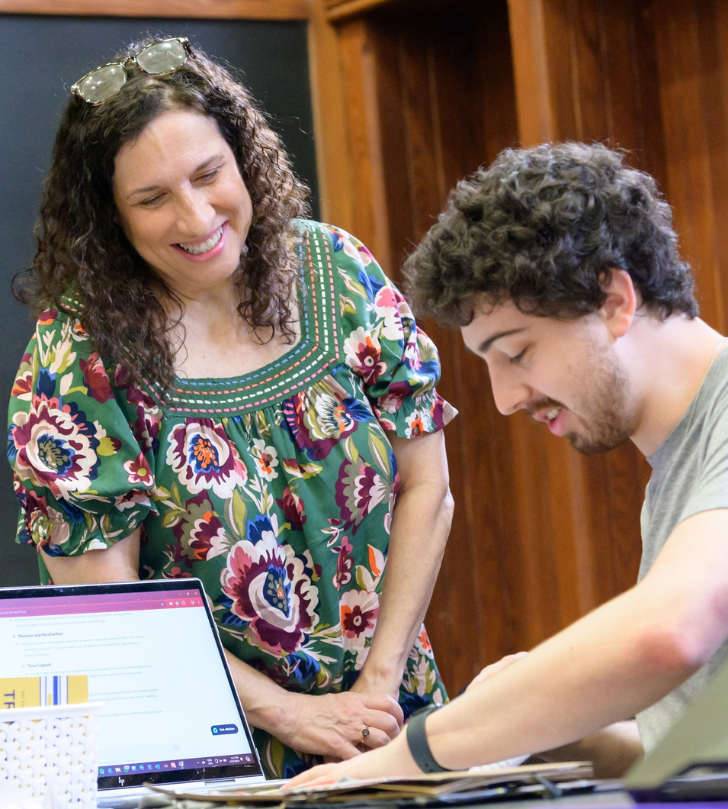
Faculty Highlight
“Didn’t Humans Used to Do That? Collaborating and Co-Creating with Generative AI”
Madalene Spezialetti
Associate Professor of Computer Science

Slide 7
DURATION:
Quick Break!
NEXT SESSION: MAKING AI WORK FOR YOU

Slide 8
MAKING AI
WORK FOR YOU
AI for Teaching
Digital Learning & Scholarship Team
AI for Learning
Digital Learning & Scholarship Team
AI for Research
Amy Harrel
Head of Collections, Research, and Instruction

Slide 9
MAKING AI WORK
FOR YOU:
AI FOR TEACHING
Presented by Instructional Technologist Team

Slide 10
Tips to get started:
A prompt is how you instruct an AI tool to perform a task for you
You can think of a prompt as a recipe for an AI tool
Include the correct “ingredients” – words and structure – for a higher quality response
Prompting with AI

Slide 11
Academic Prompts
There are numerous academic prompts and prompt repositories you can use to get started (and learn from).
To start, feel free to use the examples at the bottom of the DL&S prompting blog on the AI Resources page:
Prompting with AI – Digital Learning & Scholarship

Slide 12
Refined Prompt and Output
“I am an instructional technologist giving a workshop on ARCGIS StoryMaps. Create five ways for me to engage with undergraduate students at a small private liberal arts college. Every student has a laptop and internet access. Provide detailed examples. Gamify these ideas to increase student engagement”.
Link

Slide 13
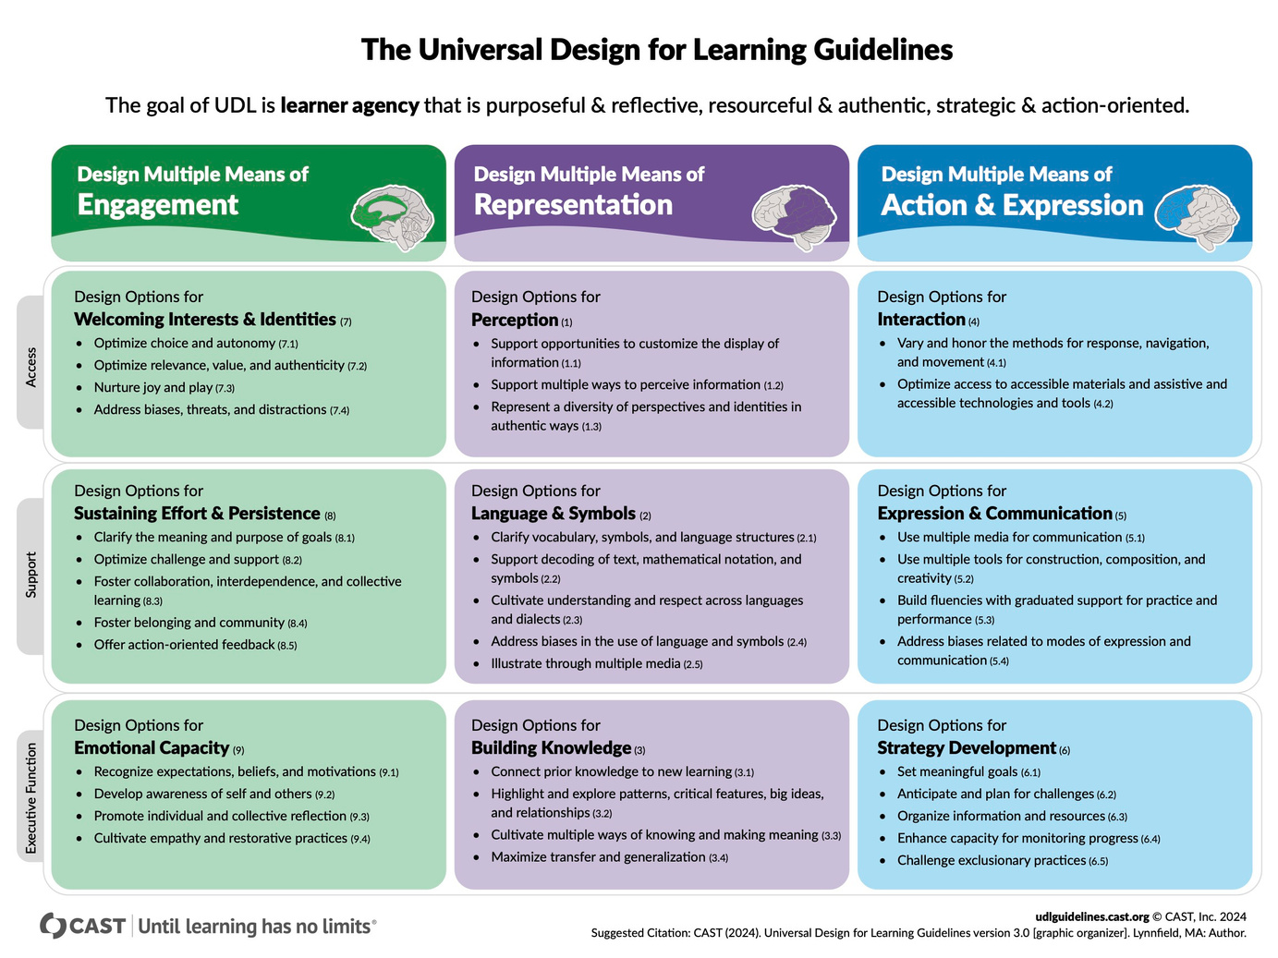
How can
AI help ?
Universal Design for Learning
is a framework to develop learning experiences that are accessible to all students

Slide 14
Customize Content
01
generate multiple versions of the same content (e.g., simplified, expanded, or visualized).
ChatGPT - Simplified
Enhance Accessibility
02
generate transcripts, captions, creating graphics, and text-to-speech/audio resources.
Generated by PictoryAI
Develop Tiered Assessments
03
Design quizzes or problem sets that address different skill levels or learning styles.
ChatGPT - Create tiered questions based on Bloom’s taxonomy.
AI-Powered Universal Design for Learning
04

Slide 15
Using AI to Find Open Educational Resources
Problem: Costs to students are rising. It would be nice to have quality resources to use and teach with that aren’t behind paywalls. Finding these resources feels overwhelming and time consuming.
Solution: Have AI provide some examples for your specific class and needs.
Prompt: You are a professor at a small liberal arts college designing a 1st year course on evolutionary biology. Please suggest a list of OER in a list that would benefit the class.
Link

Slide 16
?
Question
How are you using AI to
improve or simplify teaching?

Slide 17
MAKING AI WORK FOR YOUR STUDENTS:
AI FOR LEARNING
Presented by Instructional Technologist Team

Slide 18
NOTEBOOK LM
Upload and explore
your sources
Engage directly with
your materials
See the source, not just the answer
Sources, queries, and responses are not used for training data

Slide 19
Use Case: StoryMaps Database
My role: Learn and deliver StoryMaps workshops
35 resources identified (initially saved to browser bookmarks)
Uploaded to Notebook LM
Saved time and improved workshop quality

Slide 20
Demo: NotebookLM

Slide 21
Use AI to Support Students Study and Practice Habits
Empower and demonstrate to students how to use AI ethically :
Custom Study Guides:
Summarize lecture notes or textbooks
Ex. Use NotebookLM to create a bulleted summary
Practice Problems and Interactive Study Tools:
Generate example problems with solutions at various difficulty levels.
Ex. Quizlet for flashcards, practice tests, or study guide
Immediate Feedback:
Explaining mistakes or provided hints.
Ex. Use ChatGPT to get ”unstuck” and build comprehension

Slide 22
Reduce Anxiety About Getting Clarification
Problem: Students may feel intimidated about asking for clarification in class or one-on-one.
Solution: Have AI explain a concept to a five year old.
Side Effect: The examples given are often memorable and can also create conversation starters for how accurately the process was described.
Prompt: You are an expert in chemistry and pedagogy. Can you please explain the concept of electron cloud orbitals to me like I am five years old? Use plain language, and feel free to utilize metaphors or other parallels that will strengthen my understanding of the concept.

Slide 23
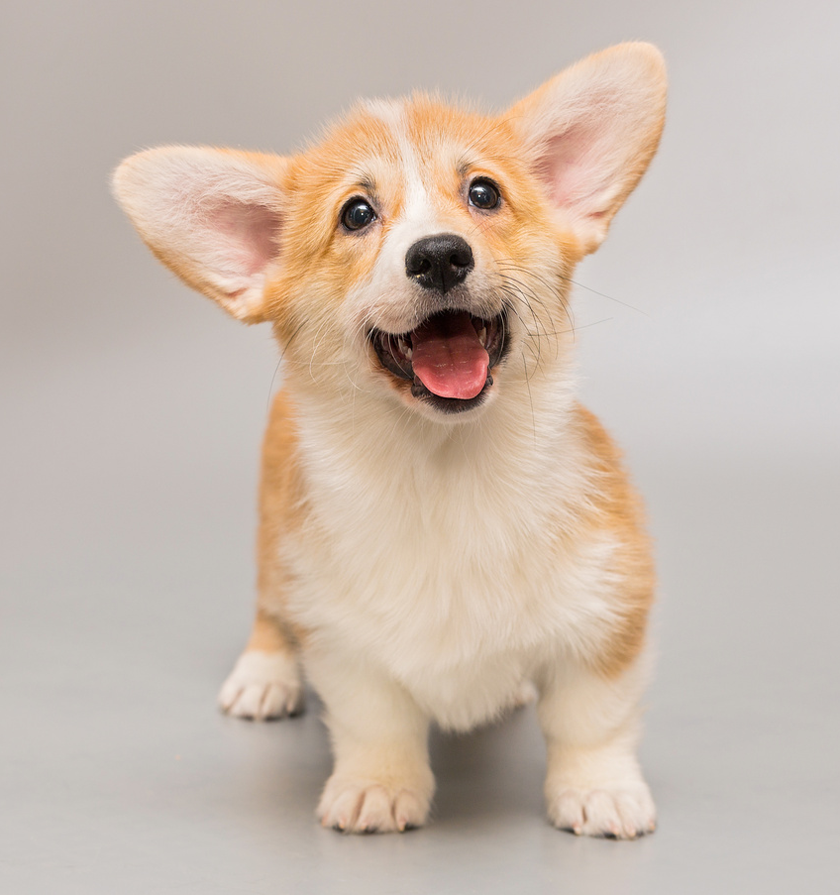
Okay, imagine you have a house with a very excited puppy that loves to zoom around. You know the puppy is always somewhere in the house, but you can't say exactly where at any moment—it's just moving too fast!
Now, in the world of tiny things like atoms, there are also little particles called electrons that zoom around the center of the atom, which is like the puppy's favorite spot, the couch. Instead of running in a straight line or a perfect circle, these electrons zoom all over the place in a fuzzy, blurry area called an electron cloud.
The cloud is like a "puppy zone." It shows where the electron is most likely to be found, kind of like saying, "The puppy loves hanging out in the living room, but it could also be in the kitchen." The shape of this "puppy zone" depends on the energy of the electron, just like how your puppy might zoom differently if it's sleepy or super excited.
Scientists call these different shapes orbitals, and they can look like spheres, dumbbells, or even more wiggly shapes. So, orbitals are like the map of where the electron probably is—but just like you can't always pinpoint your puppy in the house, you can't always pinpoint the electron exactly in its cloud!

Slide 24
Prompt #1
You are a professor at a small liberal arts college and an expert in writing and rhetoric. Evaluate the following student emails and provide a list of suggestions on how they can improve tone and clarity.
ALTERNATIVE PROMPTS TO AID IN CLARIFICATION
Prompt #2
You are an expert in [Insert Topic]. For every question you receive, please provide 5 additional questions that could enhance the understanding of the same topic.

Slide 25
?
Question
How are you using AI to
improve or simplify learning?

Slide 26
MAKING AI WORK FOR YOU:
AI FOR RESEARCH
Blog Post
Trinity College, Hartford, Connecticut
AI-Based Library Research Tools
Presented by Amy Harrell
AI-Based Library Research Tools
Semantic Scholar
Elicit
Research Rabbit
Perplexity
Consensus
Scite

Slide 27
Student Presentation
“Writing and AI”
Taught by Alex Helberg
Visiting Assistant Professor in the Allan K. Smith Center for Writing and Rhetoric
Ethical Consequences
of Using A.I. Tools
Impacts on Environment and Labor
A.I. and Academic Integrity, Plagiarism,
and Intellectual Property
“Hallucinations,”
Fabrications, Misinformation
generated by LLMs

Slide 28
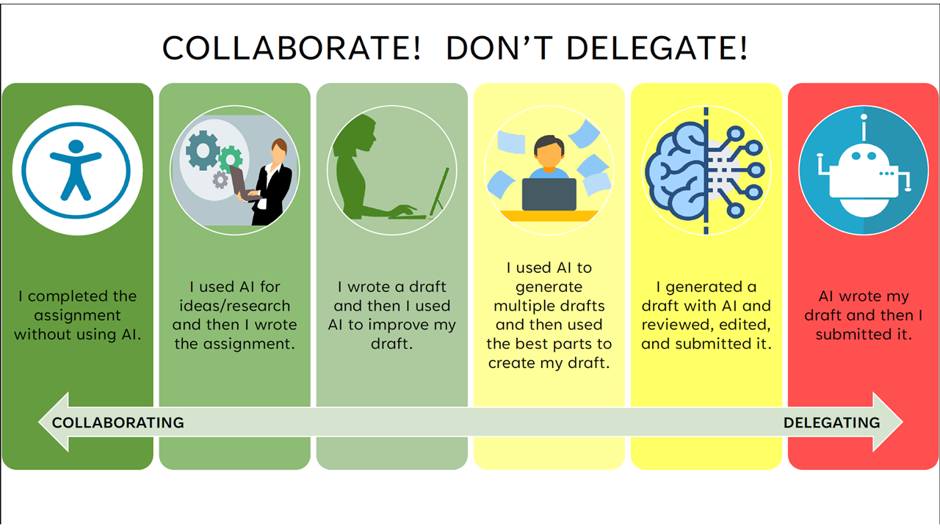
Syllabus Statements

Slide 29
Syllabus Workshop
Joshua King
Senior Lecturer in Language
and Culture Studies
Brianna Halladay
Assistant Professor of Economics
John Ashby
Assistant Professor of Chemistry

Slide 30
Brianna Halladay
Current Syllabus Statement:
New Syllabus Statement:
You may have heard by now about increasingly popular publicly-available artificial intelligence (A.I.) tools that produce writing when given human input/prompts. There have been many concerns raised by teachers across grade levels and institutions about the prospect of students using such technologies to cheat by having an A.I. write their essays or other writing assignments for them. We will doubtless have ongoing conversations in this course about the role of A.I. writing in our own processes, and even the ways that A.I. can be helpful to us as writers. However, a word of caution: any attempt to pass off A.I. writing as your own in this class constitutes a violation of Trinity College's intellectual honesty policy. As the Student Handbook explains, “Intellectual honesty assumes that students do their own work and that they credit properly those upon whose work and thought they draw” (28-37; 28). Failure to abide by the policy may result in censure, suspension, or even expulsion.
Use of A.I. tools is growing and expanding at a rapid pace and these tools have many useful benefits and features. However, a word of caution: any attempt to pass off A.I. writing as your own in this class constitutes a violation of Trinity College's intellectual honesty policy. Use of A.I. tools for any assignment, written or otherwise, must be disclosed in its entirety including a list of the prompts submitted to the A.I. tool and the corresponding output. Additionally, any assignment benefiting from the use of A.I. must be accompanied by an explanation for why you felt the use of A.I. would be helpful initially and your overall experience with whether it was truly helpful. Failure to abide by the policy may result in censure, suspension, or even expulsion.

Slide 31
THANK YOU
FOR PARTICIPATING
WITT 2025: Making AI Work for You and Your Students
Special Thanks To
Thea Nguyen

Slide 32
Get in touch slide
RESOURCES
David Tatem
Head of Digital Learning & Scholarship
david.tatem@trincoll.edu
Mary Mahoney
Digital Scholarship Strategist
mary.mahoney@trincoll.edu
Loren Milledge
Instructional Technologist
loren.milledge@trincoll.edu
Artificial Intelligence Resources Center
Digital Learning & Scholarship
Sheila Reagan
Instructional Technologist
sheila.reagan@trincoll.edu
Matthew Ouimette
Instructional Technologist
matthew.ouimette@trincoll.edu

