Slide 1
Didn’t Humans Used
To Do That?
Collaborating and Creating
with Generative AI
Madalene Spezialetti

Slide 2
Create

Slide 3
Create
Collaborate

Slide 4
Create
Collaborate
Communicate

Slide 5
Create
Collaborate
Communicate
Currate

Slide 7
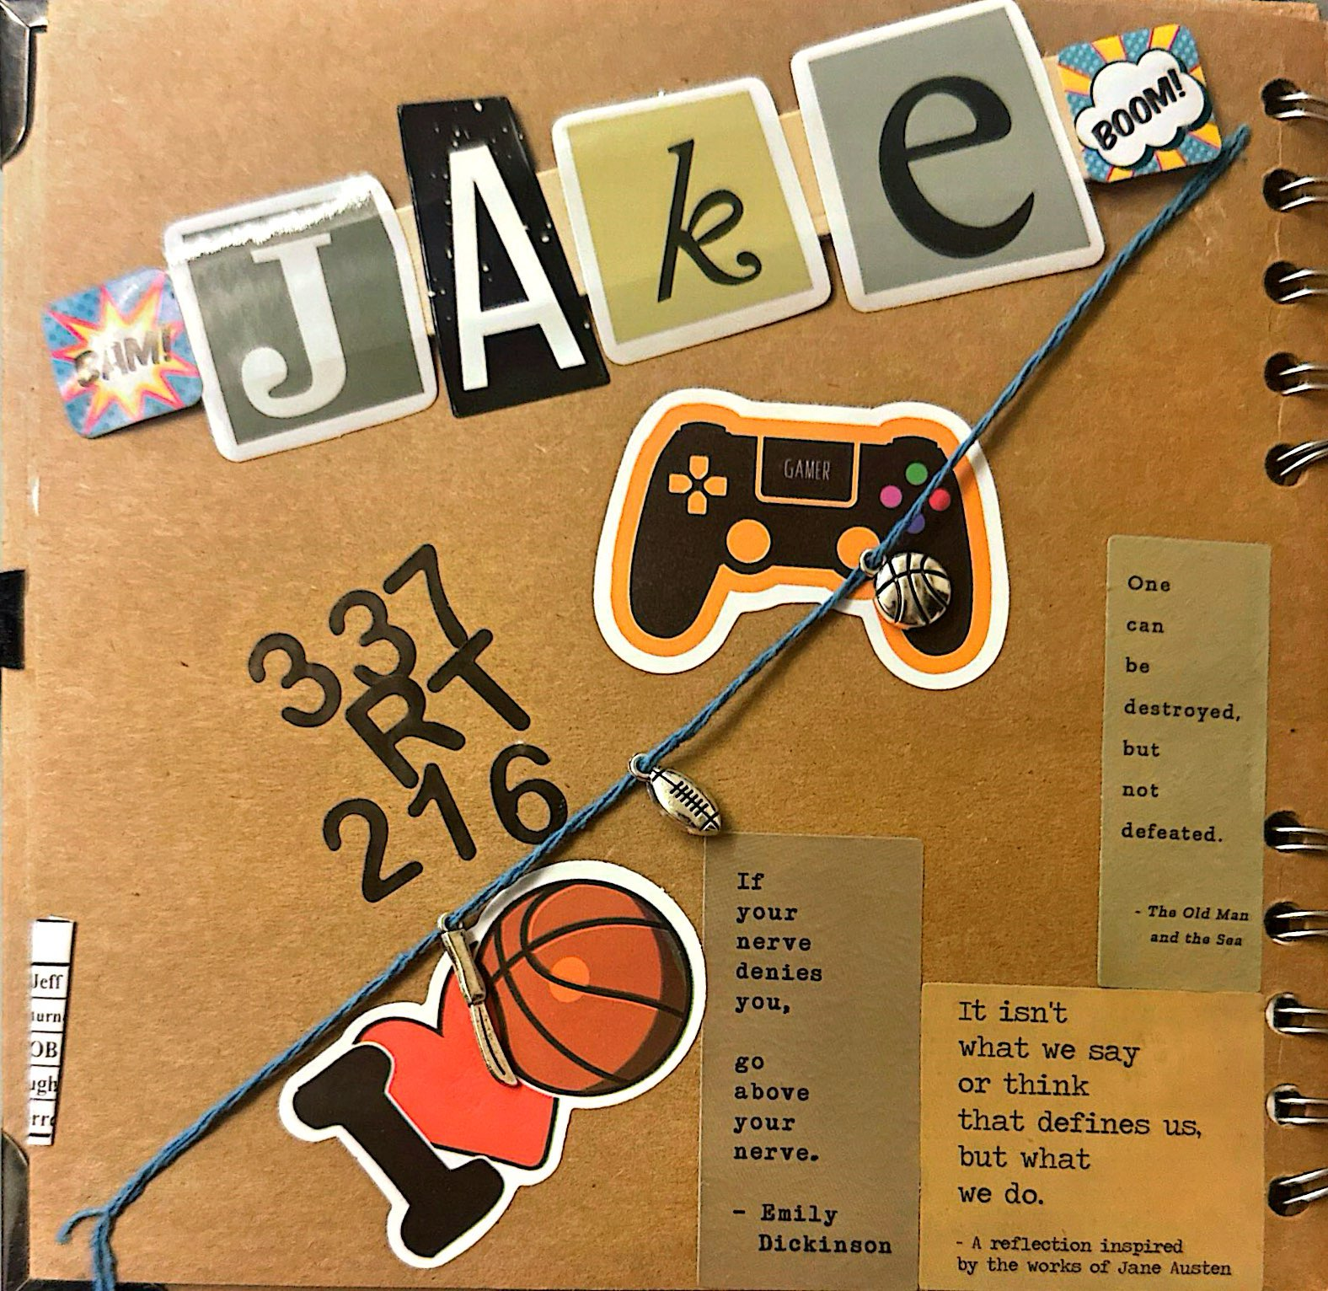
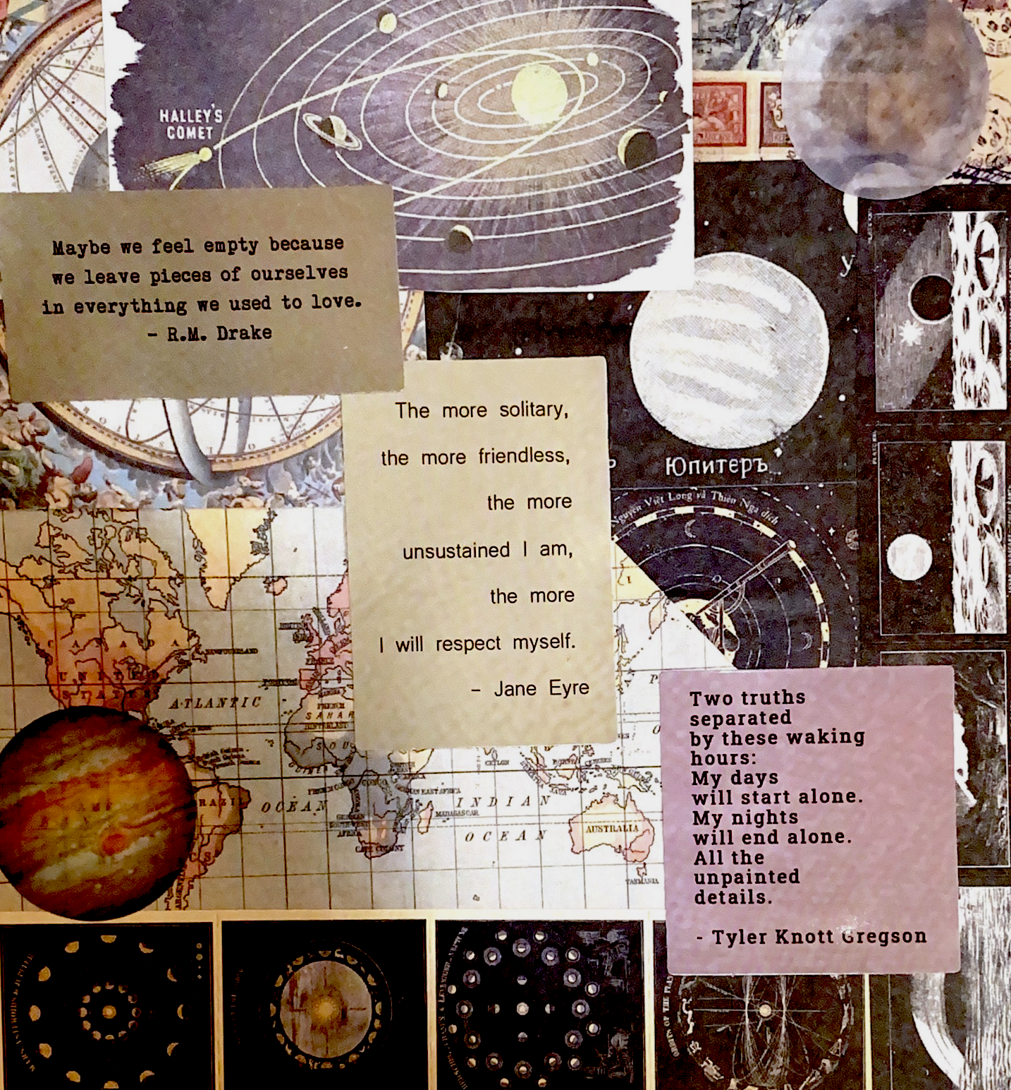
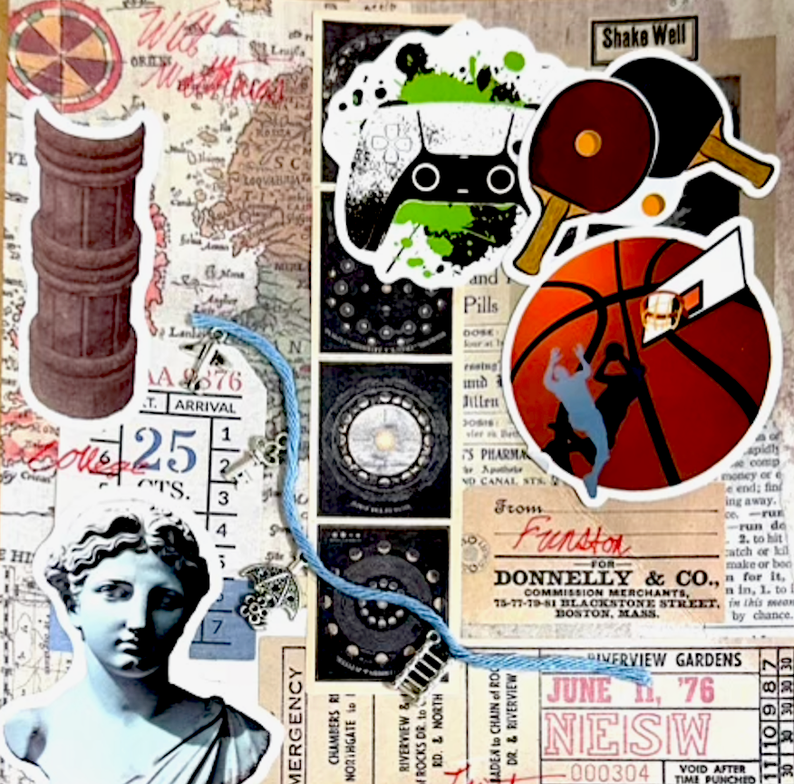
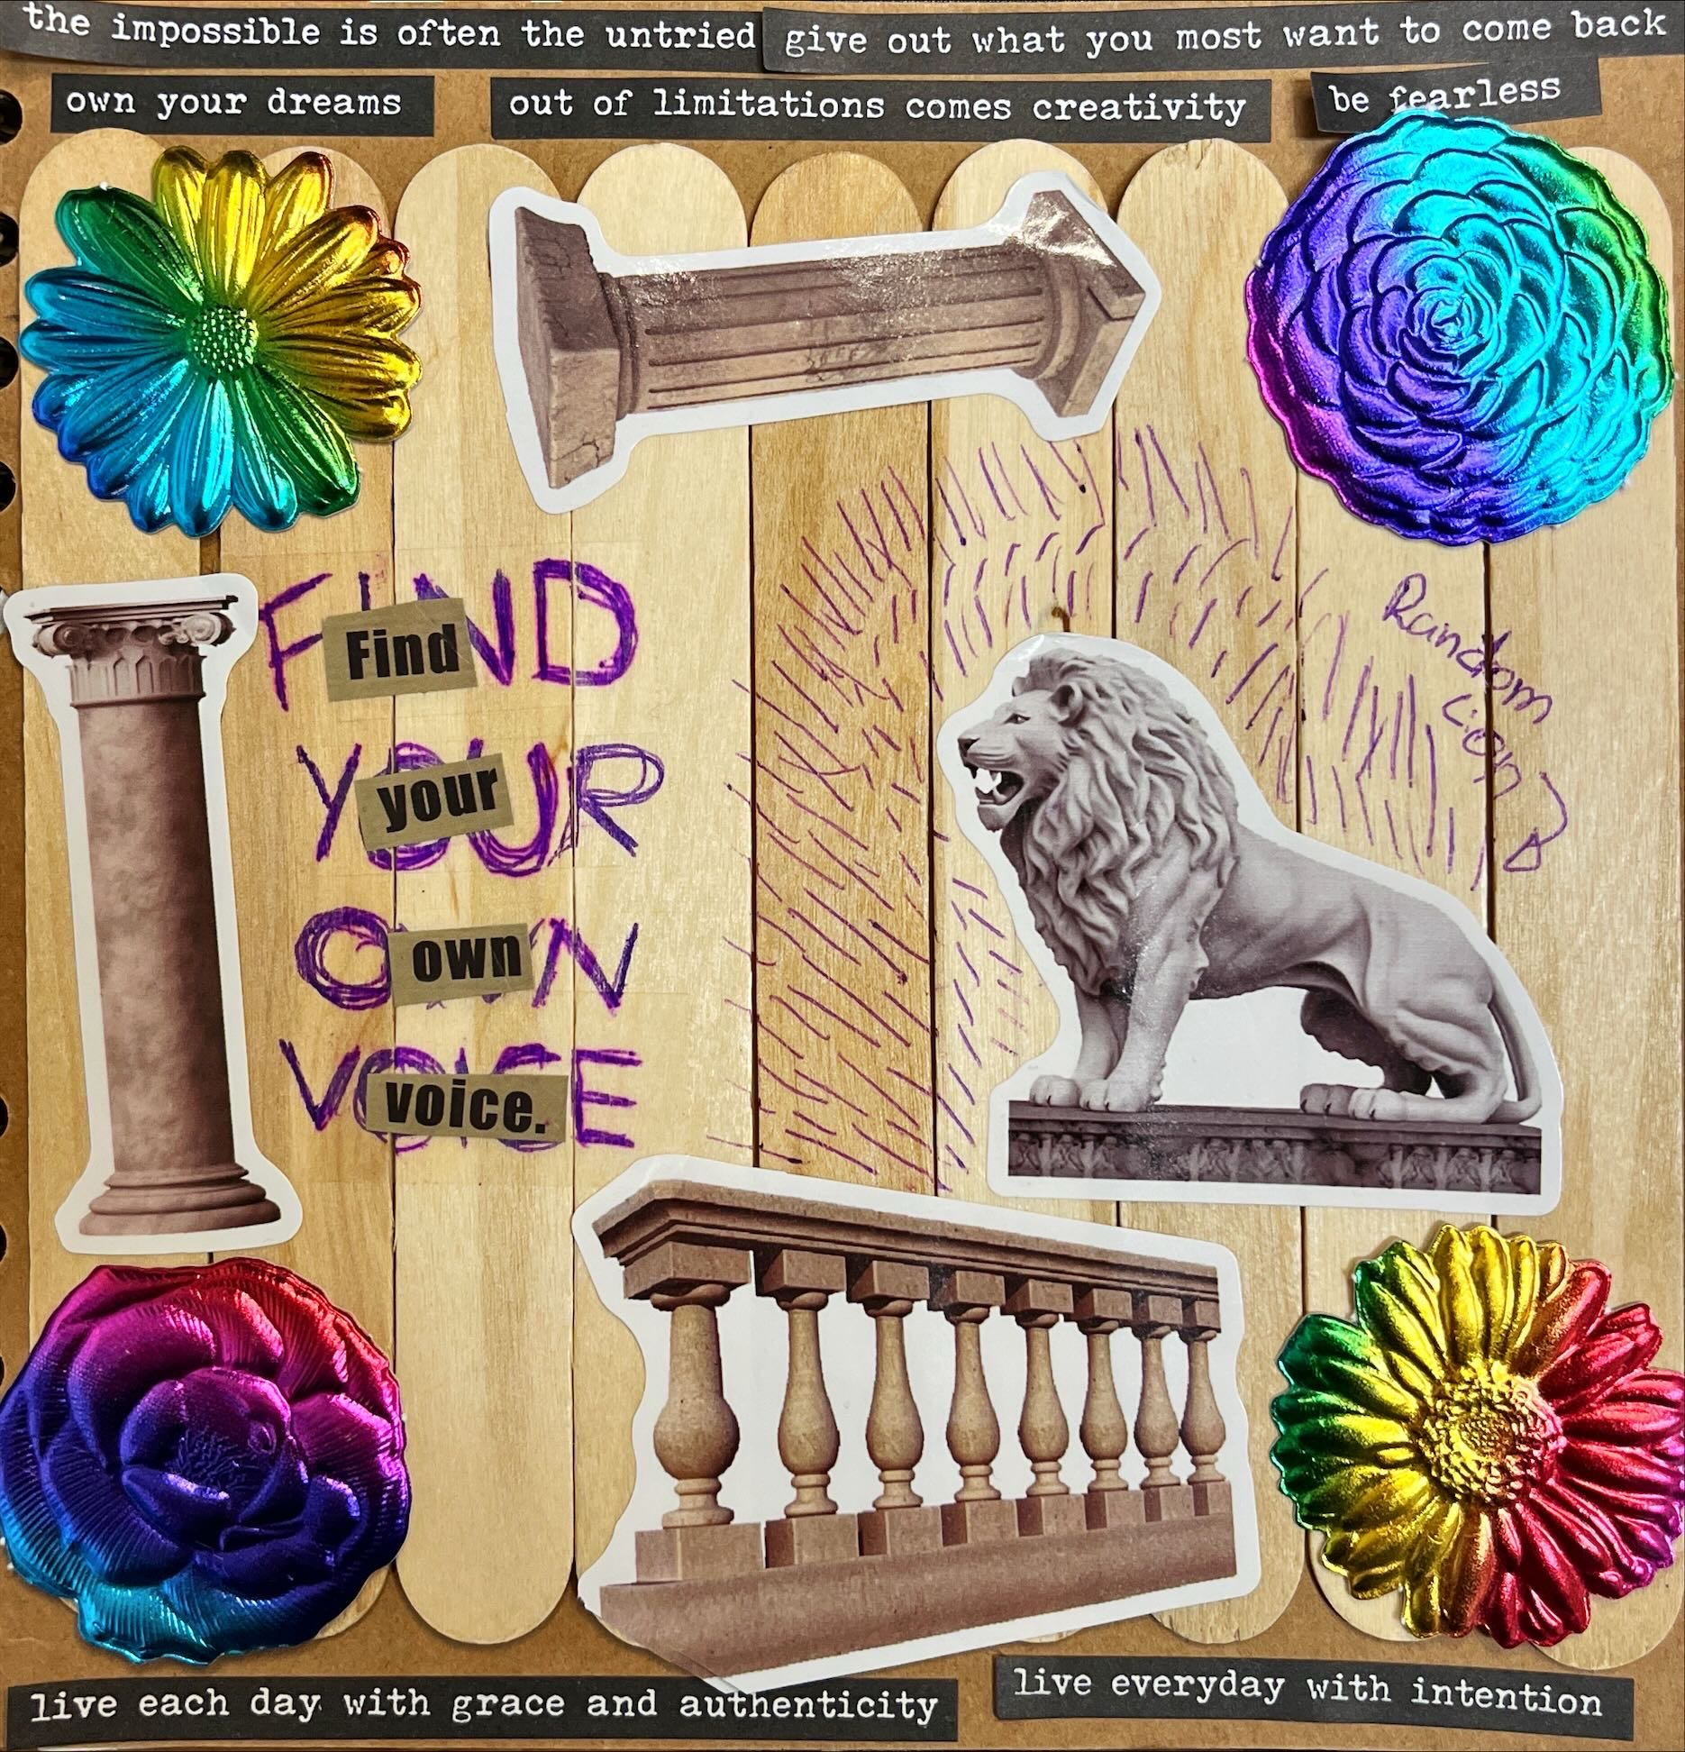
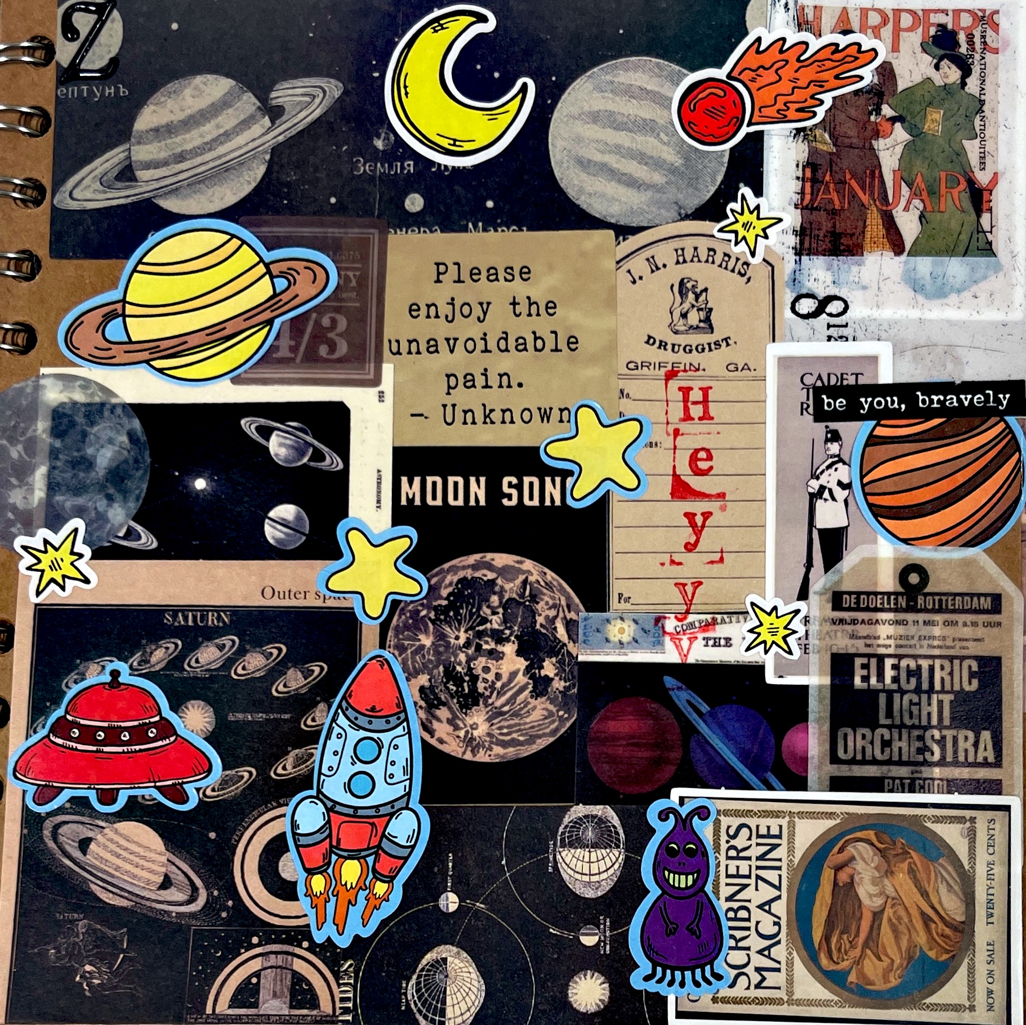
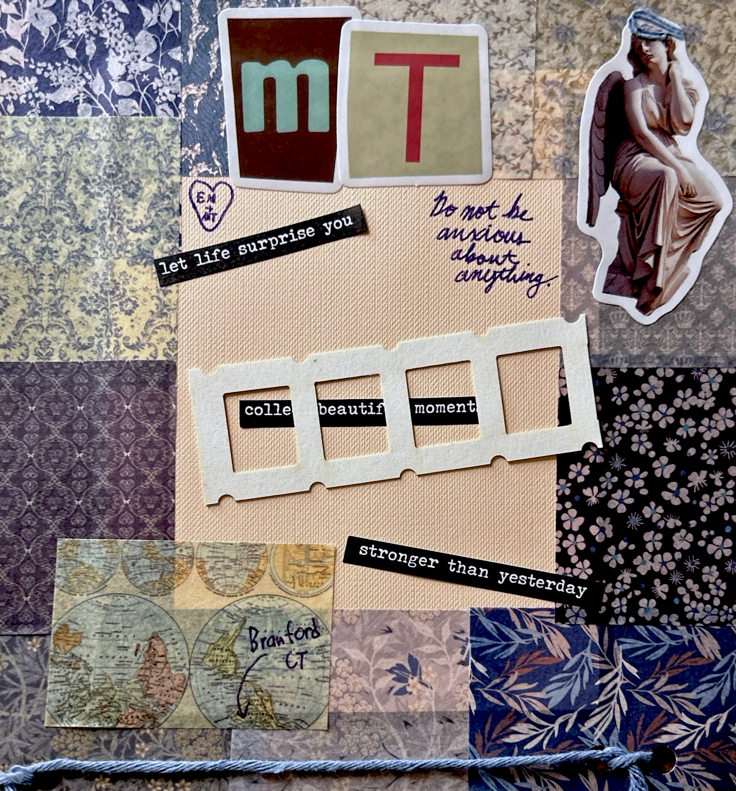
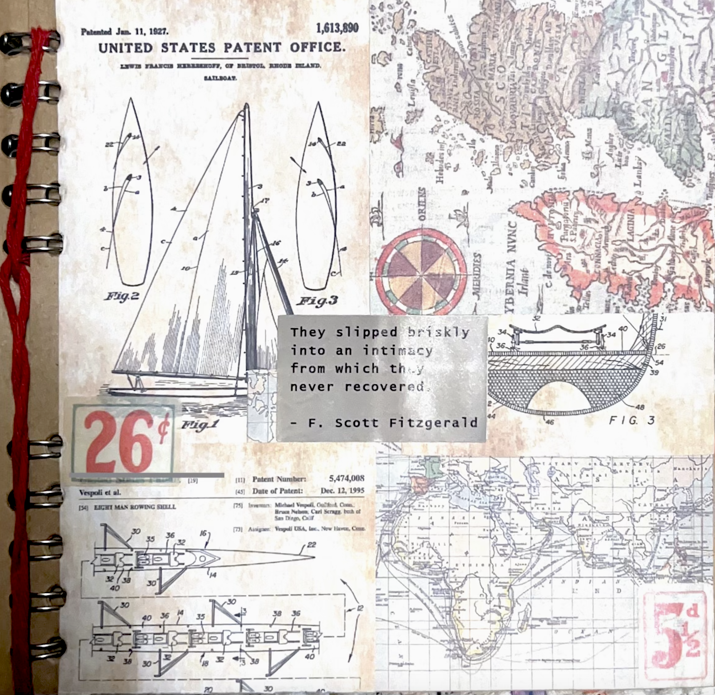
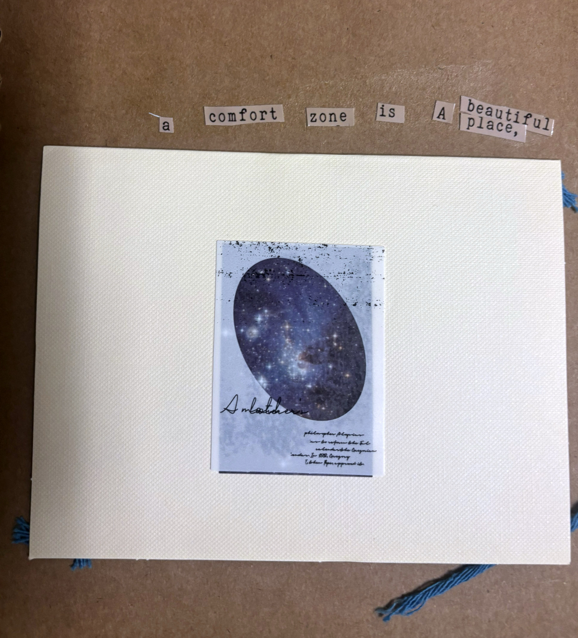
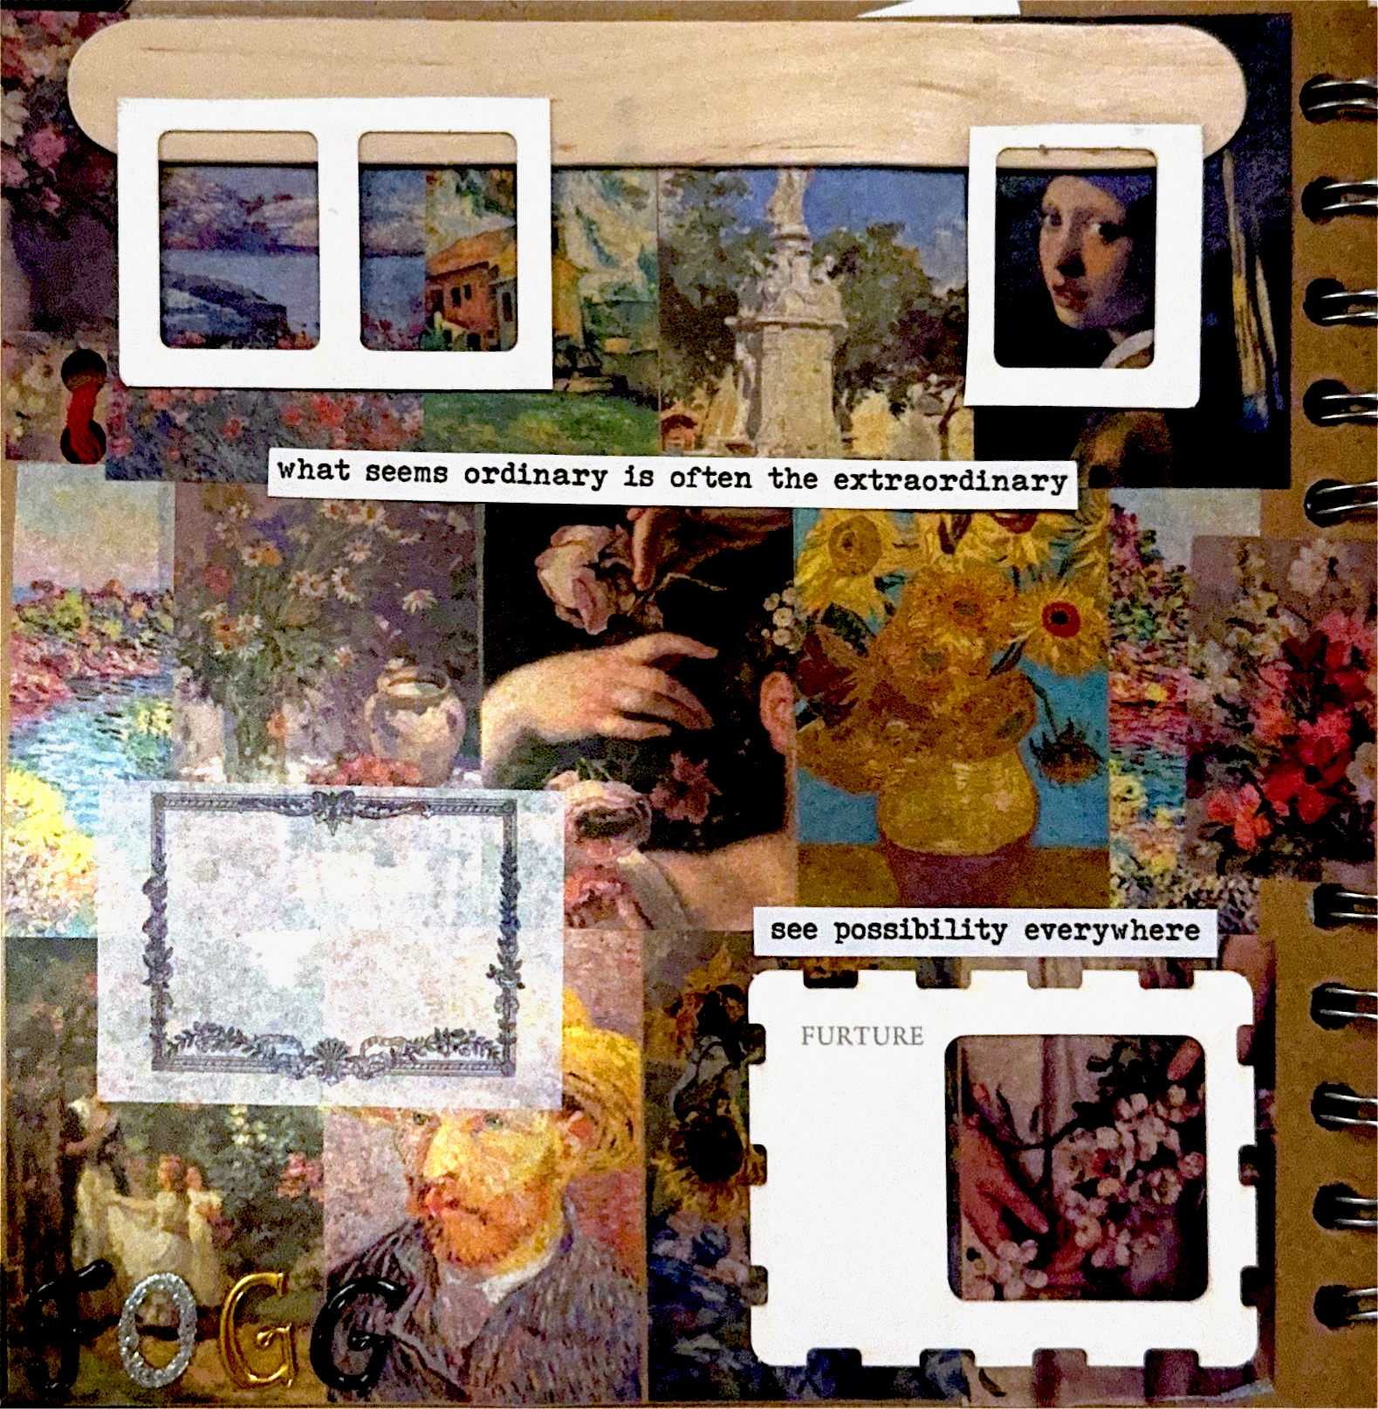
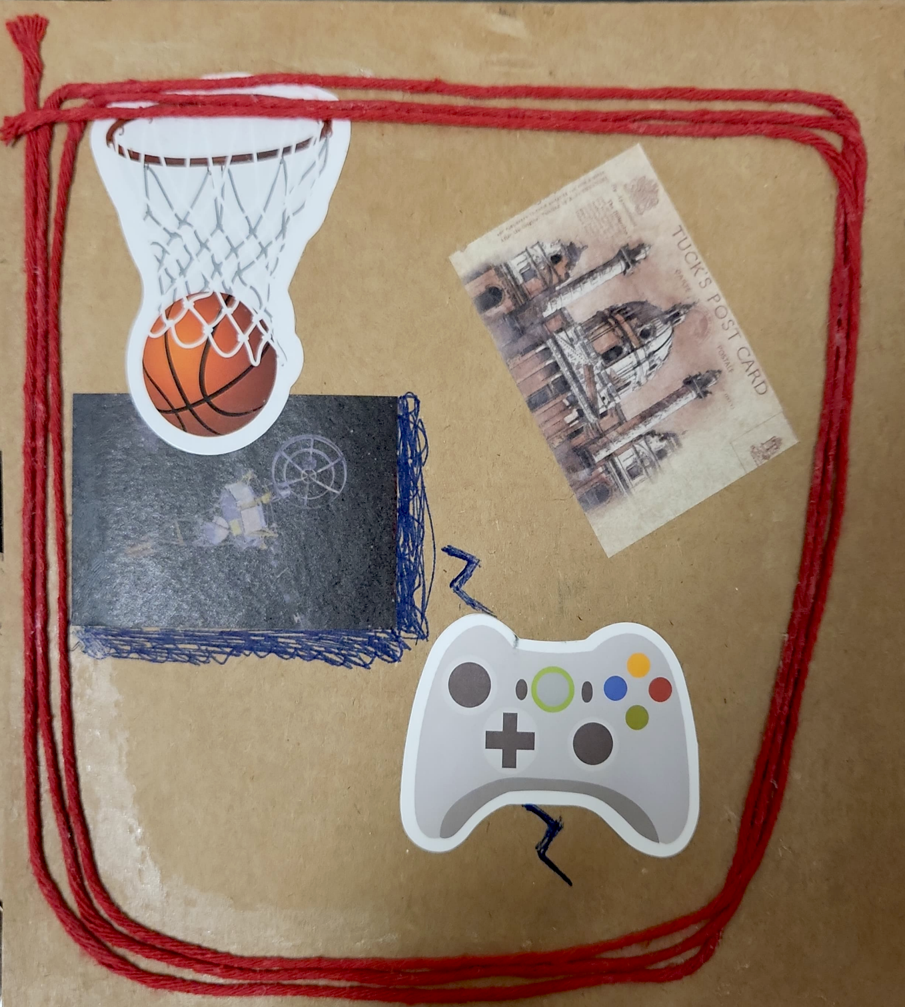
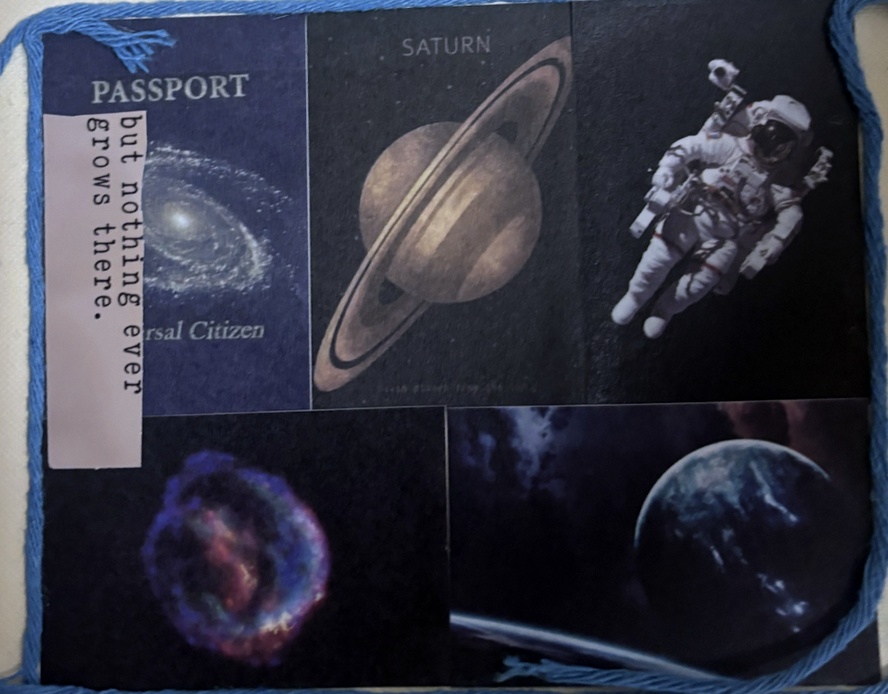
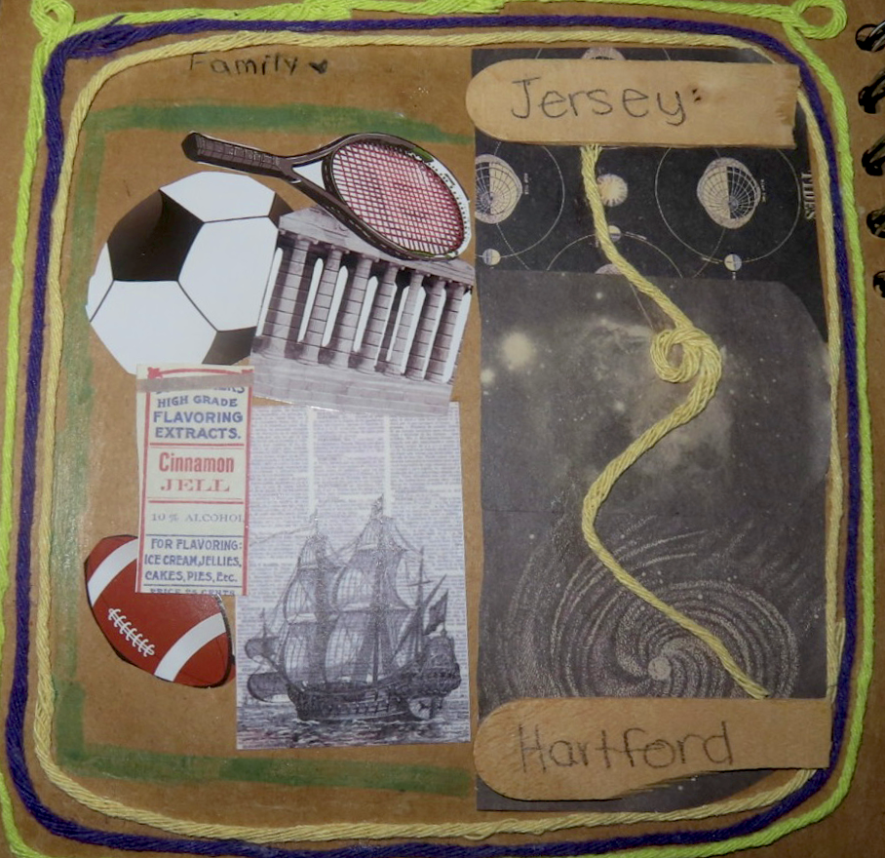
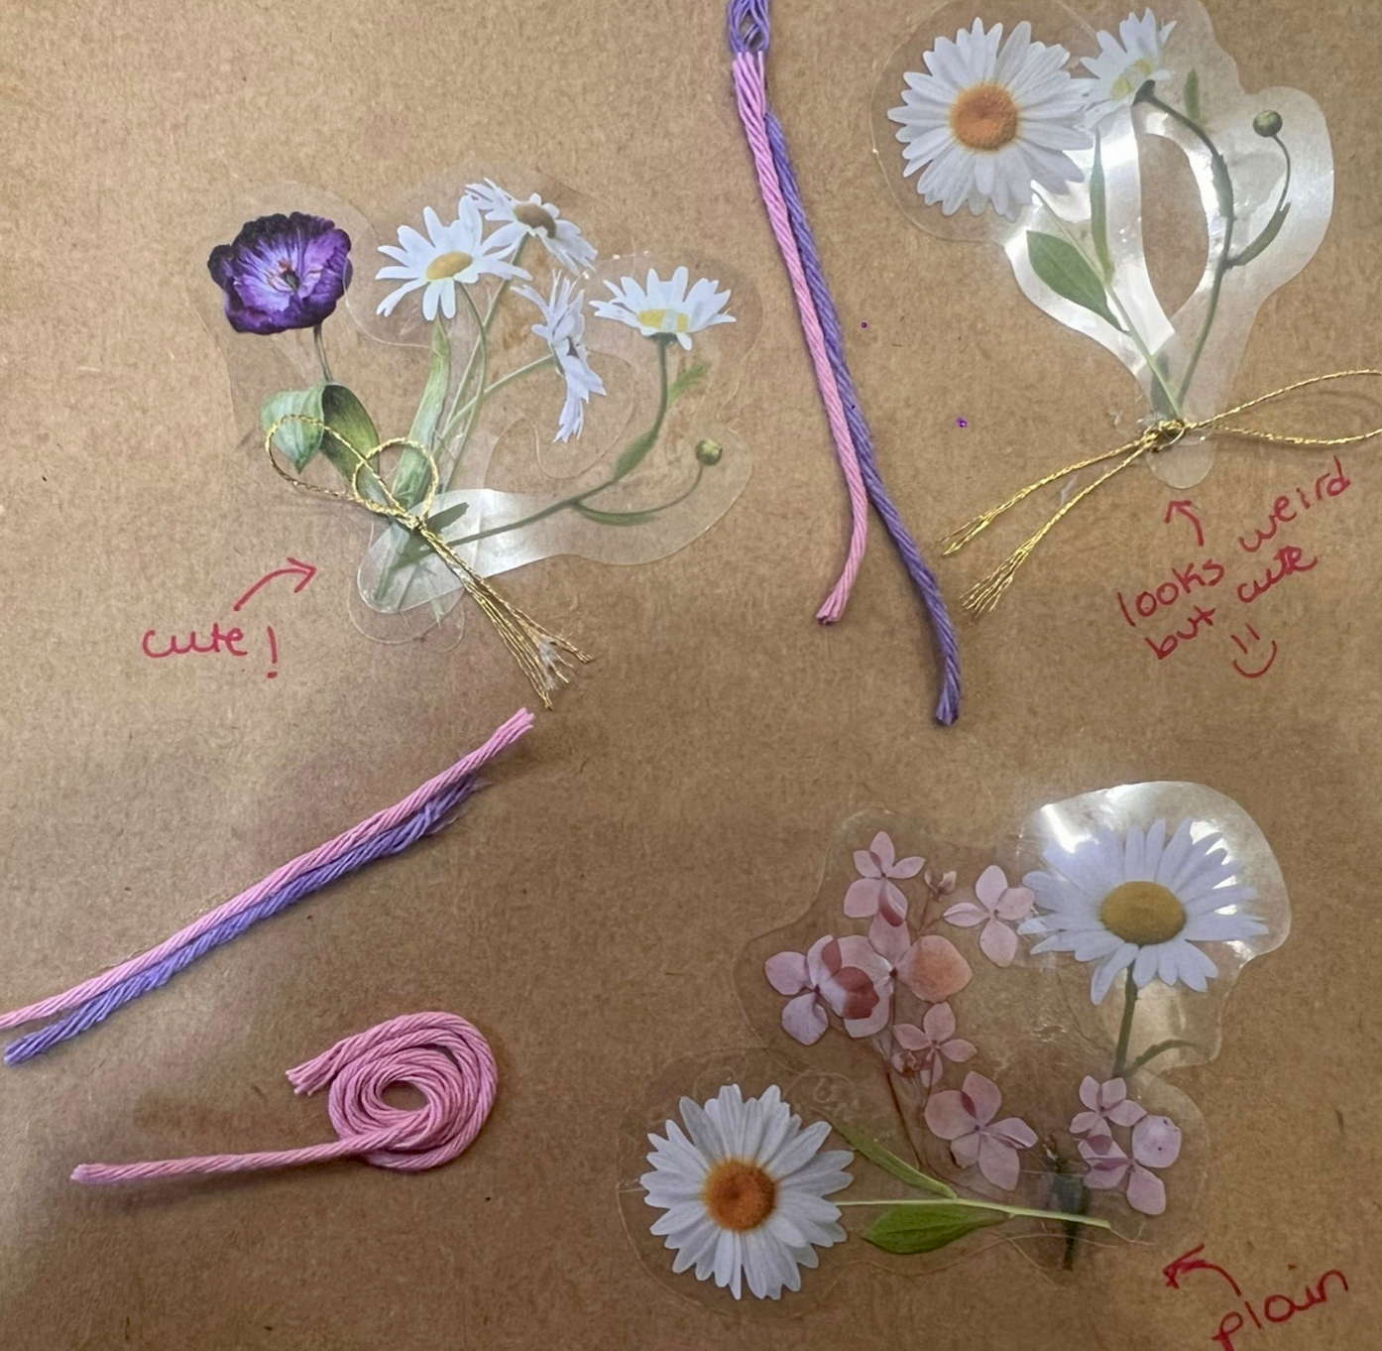
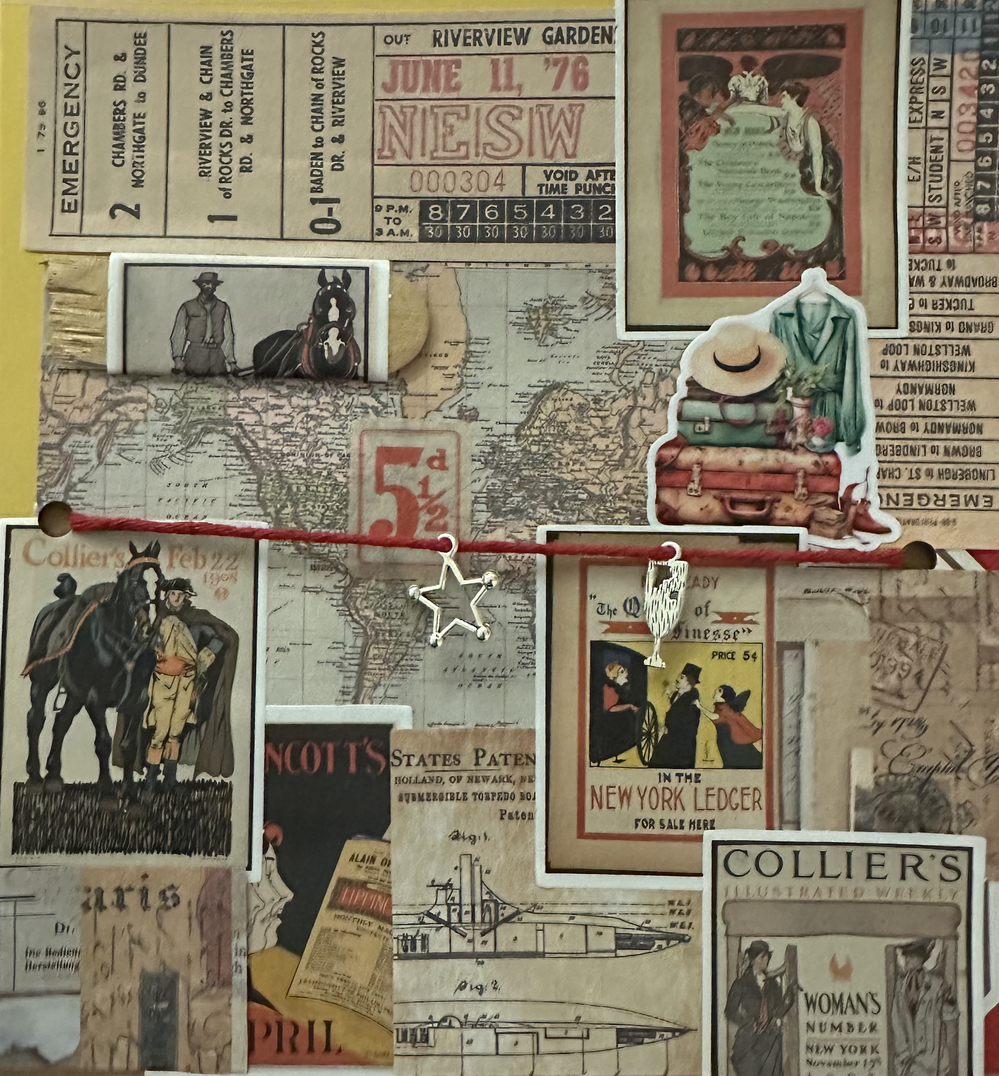
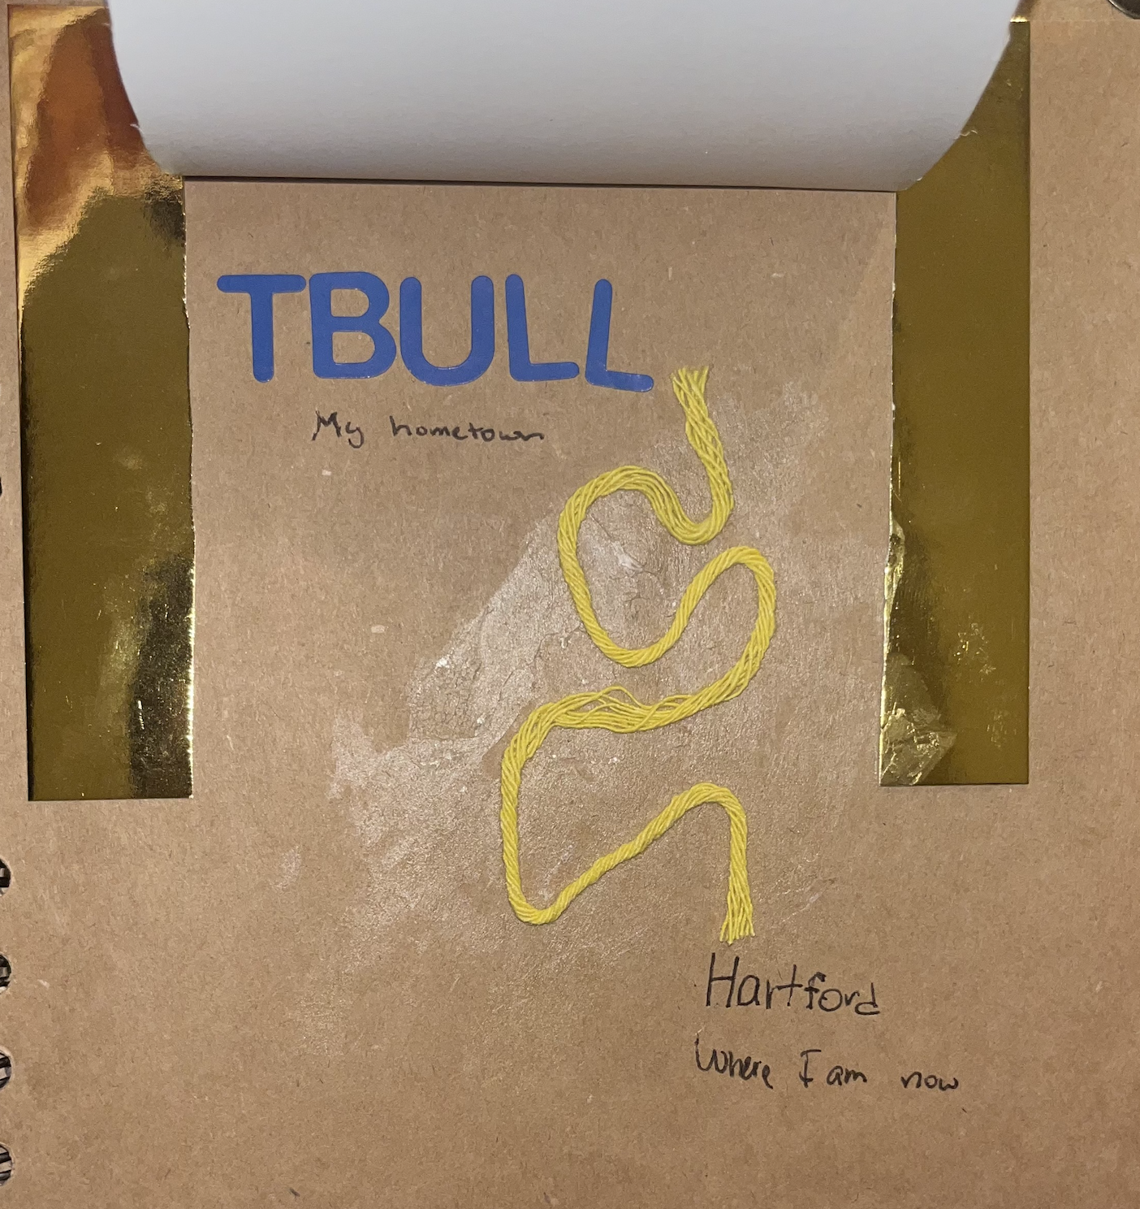
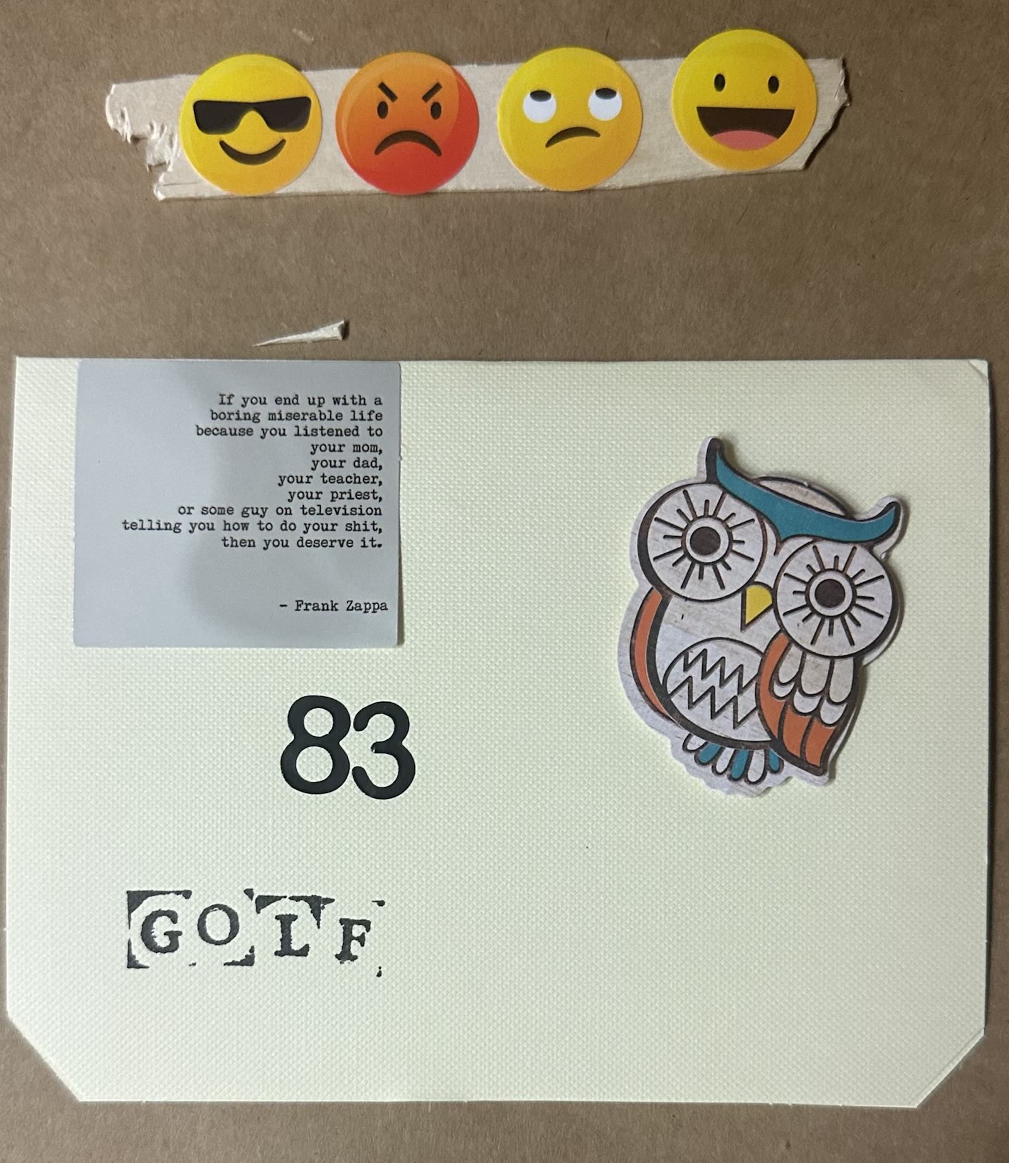
STOLEN IDEAS
"GOOD ARTISTS COPY. GREAT ARTISTS STEAL" - Pablo Picasso
STEAL 3 IDEAS FROM FELLOW STUDENTS

Slide 9
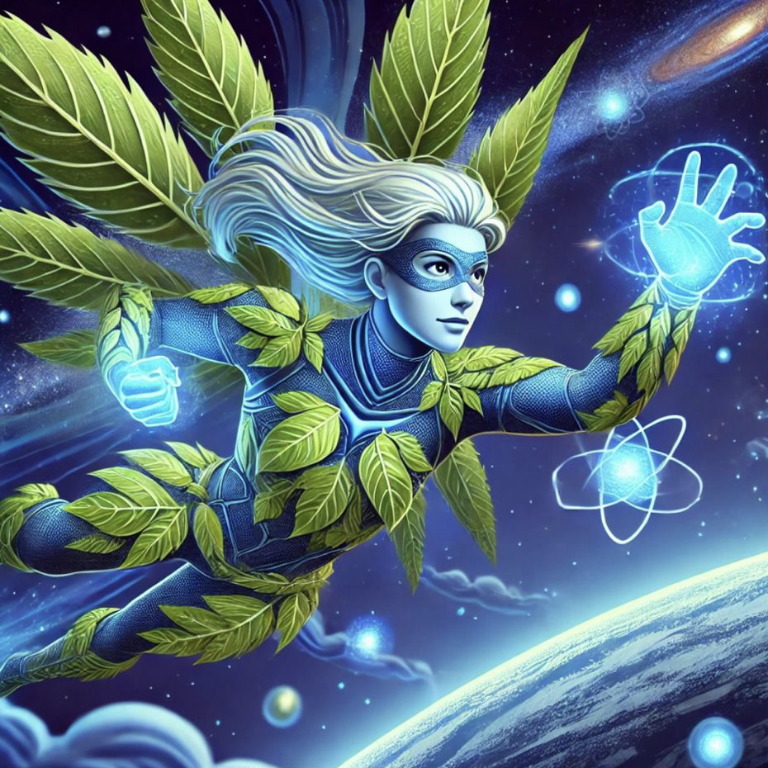
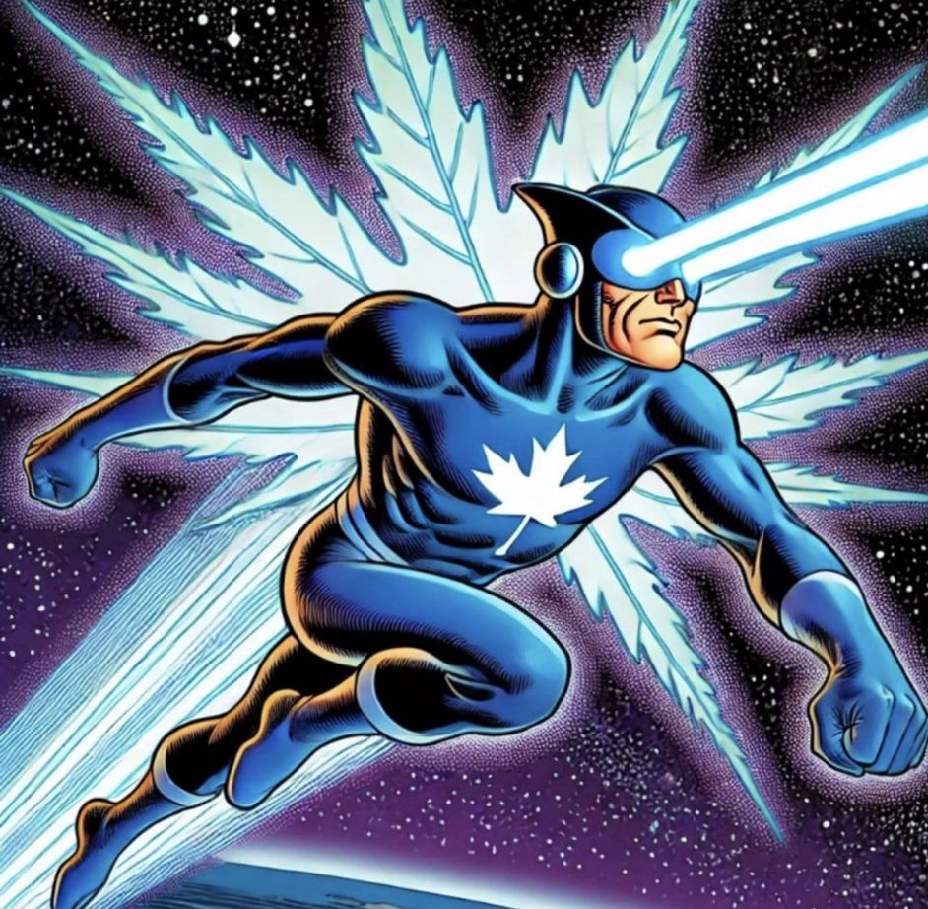
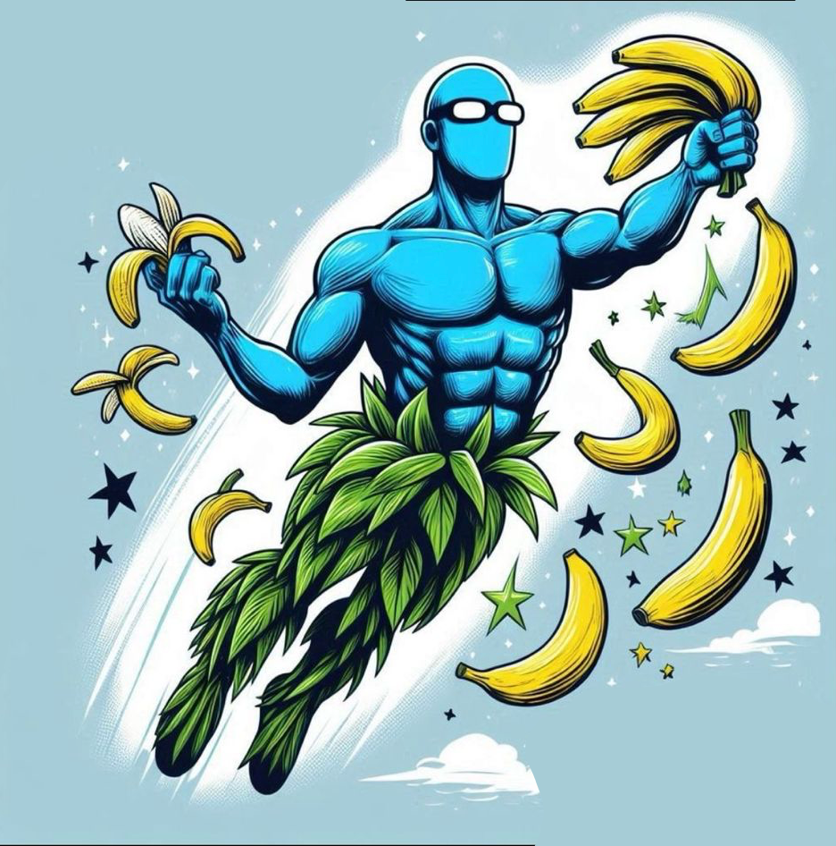
The Vegan Vanquishers
"Evil's Worst Salad Day"
B
Binary Buffet
Panel 1: Setting: Space station "The Greenhouse" - a massive structure with botanical gardens visible through its windows. CAPTION: "The Greenhouse" Space Station - Home of The Vegan Vanquishers BLUE STEEL: Another peaceful day protecting our space gardens...
Panel 7: Neon Chloe creating a firewall with her neon bubbles. NEON CHLOE: My bubbles can contain the virus! BINARY BURGER: Your organic firewalls are no match for my processing power!
Panel 2: Interior of space station's main control room, filled with plants and holographic screens. NEON CHLOE: Alert! Someone's hacking our hydroponics system! BANANALDINHO: Not the space kale!
Panel 8: Bananaldinho confronting digital burger minion. BANANALDINHO: Time for a healthy snack transformation! SNAP SFX: POOF! Digital burgers turn into actual bananas
Panel 9: Team working together. Blue Steel's lasers channeling through Neon Chloe's bubbles while Bananaldinho's banana-transformed minions create a barrier BLUE STEEL: Together! My lasers through your bubbles... NEON CHLOE: ...will create a clean boot sequence! BANANALDINHO: And my banana firewall will keep it contained!
Panel 3: Computer screens showing a malicious program represented as a pixelated burger icon COMPUTER SCREEN: "IMPLEMENTING PROTOCOL: MEAT.EXE" BLUE STEEL: Someone's trying to reprogram our food synthesizers...
Neon Chloe
Blue Steel
Panel 4: Villain reveal. A hologram appears showing BINARY BURGER, a figure made of computer code wearing a fast-food uniform BINARY BURGER: Greetings, Vegans! I'm Binary Burger, and I'm converting your precious garden into a virtual fast-food franchise! NEON CHLOE: A rogue AI with an appetite for destruction!
Panel 10: Binary Burger's program beginning to break down. BINARY BURGER: No! My code! It's being overwritten with... organic algorithms? NEON CHLOE: Sometimes the best antivirus is a little slice of nature!
Panel 5: Planta beginning to transform into digital versions of fast food. BANANALDINHO: The tomatoes! They're turning into binary code! BLUE STEEL: Quick! We need to protect the seed bank!
Panel 11: The team standing victorious among restored plants. Binary Burger reduced to a small harmless program in a bubble BLUE STEEL: The garden is safe! BANANALDINHO: And look - we've even converted Binary Burger into a nutrition-tracking app!
Panel 6: Blue Steel uses his laser vision to sever network connections. BLUE STEEL: My lasers can cut the network cables! BINARY BURGER (O.S.): Nice try, but I'm already in the cloud!
Panel 12: The team relaxing in their Garden. Binary Burger's friendly app version helping monitor plant growth BINARY BURGER (NOW AS APP): Analyzing optimal growing conditions... NEON CHLOE: Looks like we just debugged dinner! BLUE STEEL: All in a day's work for... ALL THREE: THE VEGAN VANQUISHERS!
Bananaldinho

Slide 10
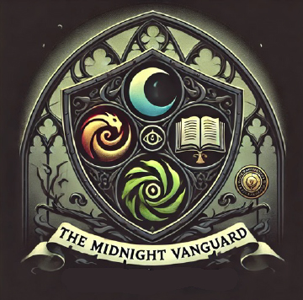
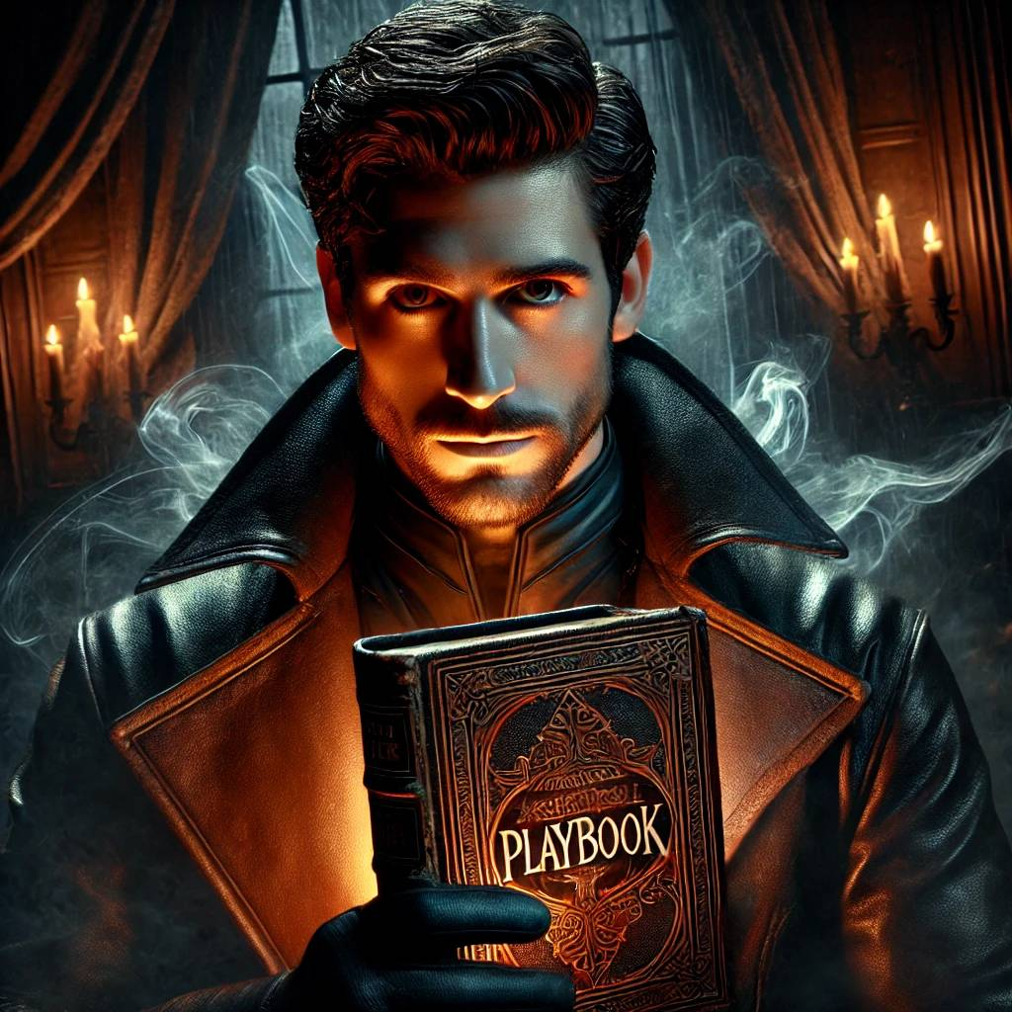
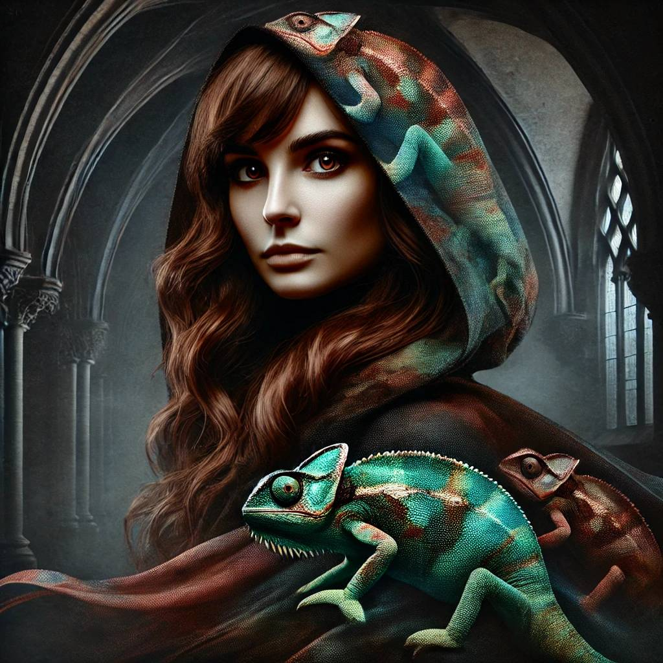
The Midnight Vanguard
"In the darkest hour, we hold the line"
Playbook for a Vampire
Panel 1: Setting: The gates of Dracula's castle. Thunder rumbles in the distance. Chameleon: "This ends tonight. No more mistakes." Playwright: "Just stick to the play. I’ve scripted a masterpiece." Financier: [smirking] "Your ‘masterpiece’ better work, or we’re toast."
Panel 7: Battle erupts. Dracula moves like a shadow.
Chameleon: [dodging claws] "Keep him off balance!"
Playwright: [flipping through his glowing playbook] "Time for some theatrics." A phantom knight emerges from the pages, slashing at Dracula.
Panel 2: Inside the castle, flickering torches cast long shadows. Chameleon: [whispering] "He’s close. I’ll scout ahead." She melts into the shadows, her colors fading. Playwright: "She’s brilliant. Wish someone was half as subtle." Financier: "Subtle doesn’t pay the bills, Playwright"
Panel 8: Dracula shatters the knight and turns on the Financier. Financier: [throwing cursed coins] "Try this on for size!" The coins pin Dracula’s arms, glowing with eerie power. Dracula: [snarling] "Mortal tricks! Do you think wealth holds power over me?"
Panel 3: Scene shifts to Dracula’s throne room. Empty, but dripping with menace. Chameleon: [reappearing] "He’s already gone. He knows we’re hunting him." Playwright: "Good. Let him run. The best villains always do before the curtain drops." Financier:[grumbling] "Always a monologue."
Panel 9: The trio regroup in Trinity College’s chapel, the Gothic spires glowing under the moonlight. Chameleon: "The chapel will weaken him. The stained glass—it’s our last chance." Playwright: "I’ve crafted his ending. All it needs is your color." Financier: "And my wallet, no doubt."
The Financier
The Playwright
(The Coach)
Panel 10: Dracula bursts into the chapel as the trio prepare. Dracula: "Fools! This is no sanctuary. This is my domain now!" Chameleon: [swirling colors around him] "You’re wrong, Count. This is your grave." Playwright: [opening his playbook] "Time for the final act.
Panel 4: Montage of the trio chasing Dracula across Europe. Shadows of Gothic cities flash by. Playwright: "We followed him through London, Prague, Vienna... always just behind." Chameleon: "He’s leading us somewhere. Setting the stage." Financier: "And burning through my treasury in the process."
Panel 11: Playwright reads aloud, his words glowing with power. Dracula hesitates as illusions of his past surround him. Dracula: [staggering] "No... you cannot use my story against me!" Playwright: "Your tragedy ends here." The Financier completes the ritual, coins forming a binding circle. Financier: "This cost everything, but it’s worth it."
Panel 5: Scene: New York City, a dimly lit theater. Chameleon: "This is his next move. The corruption—it’s in the air." Playwright: "A theater. Perfect. I’ll write his final act here." Financier: "Save the drama, playwright. Focus on the plan."
Panel 12: Dawn breaks through the stained glass as Dracula crumbles to ash. The trio collapse, drained. Playwright: [weakly] "We did it... didn’t we?" Financier: [laughing softly] "Your heroics finally broke even, Playwright." Chameleon: [fading colors] "At least... we did it together." Their silhouettes are bathed in morning light as their story ends.
Panel 6: Dracula appears on the stage, his crimson cloak sweeping like fire. Dracula: "Ah, my audience has arrived. So brave. So fragile." Playwright: "And you, so predictable. You’re already in my script, Count." Dracula: "Then let us see whose story will end tonight."
The Chameleon

Slide 11
Reflections on Collaborating with Humans and AI to Become a Superhero
It highlighted how essential collaboration is - whether with people or AI - in achieving a final product that balances diverse ideas and perspectives.
I learned that ChatGPT is very much a tool to help us make our artistic choices as opposed to a decision-maker that we can trust to execute our vision perfectly. This realization emphasized the importance of human oversight and interpretation in any creative process.
This has been a unique component of our semester’s journey, and I couldn’t be more interested in further exploring the existing skill disparities in human and AI landscapes and how one might perform better than the other in each task.
I told it I wanted my superhero to have blue skin, it kept making his suit blue, not his skin.
We had a great balance between human and machine, and the experience has definitely made me appreciate the power of teamwork and the potential of tools like ChatGPT to enhance it.
...much less fulfilling experience than actually doing the work to make a comic of your own without the help of generative AI.
It often acted as a neutral third party that quickly translated our abstract ideas into concrete suggestions.
The combination of human collaboration and ChatGPT assistance made the project feel dynamic and exciting. The group provided the heart and vision, while ChatGPT helped us bring everything together in creative and unexpected ways.
Because of [the group’s] collaboration, we were able to make a unique story and characters that I never would have thought of on my own, which makes this comic even more special to me.
It produces something out of nothing, so when we were stuck it could help us at any point. It would give us a good starting point, but it would sometimes take some time to align with what we were looking for.
We came up with names, and important factors in the story, and all ChatGPT did was combine all of our ideas and polish them. I do feel some sense of ownership in this project along with the people in my group.
The final product was very cool! My superhero in particular looks so much like me that it’s rather uncanny.
ChatGPT did a great job in accurately depicting each superhero along with the correct gender and correct strength attributes.
If this was individual, it would have been a way more bland comic.
I had my ideas, and they had their ideas,
and putting them all together resulted in a
nice mix of everybody’s ideas coming together as one.

Slide 12
Reflections on Collaborating with Humans and AI to Become a Superhero
It highlighted how essential collaboration is - whether with people or AI - in achieving a final product that balances diverse ideas and perspectives.
I learned that ChatGPT is very much a tool to help us make our artistic choices as opposed to a decision-maker that we can trust to execute our vision perfectly. This realization emphasized the importance of human oversight and interpretation in any creative process.
This has been a unique component of our semester’s journey, and I couldn’t be more interested in further exploring the existing skill disparities in human and AI landscapes and how one might perform better than the other in each task.
I told it I wanted my superhero to have blue skin, it kept making his suit blue, not his skin.
We had a great balance between human and machine, and the experience has definitely made me appreciate the power of teamwork and the potential of tools like ChatGPT to enhance it.
...much less fulfilling experience than actually doing the work to make a comic of your own without the help of generative AI.
It often acted as a neutral third party that quickly translated our abstract ideas into concrete suggestions.
Because of [the group’s] collaboration, we were able to make a unique story and characters that I never would have thought of on my own, which makes this comic even more special to me.
It produces something out of nothing, so when we were stuck it could help us at any point. It would give us a good starting point, but it would sometimes take some time to align with what we were looking for.
The combination of human collaboration and ChatGPT assistance made the project feel dynamic and exciting. The group provided the heart and vision, while ChatGPT helped us bring everything together in creative and unexpected ways.
We came up with names, and important factors in the story, and all ChatGPT did was combine all of our ideas and polish them. I do feel some sense of ownership in this project along with the people in my group.
The final product was very cool! My superhero in particular looks so much like me that it’s rather uncanny.
ChatGPT did a great job in accurately depicting each superhero along with the correct gender and correct strength attributes.
If this was individual, it would have been a way more bland comic.
I had my ideas, and they had their ideas,
and putting them all together resulted in a
nice mix of everybody’s ideas coming together as one.

Slide 13
Reflections on Collaborating with Humans and AI to Become a Superhero
It highlighted how essential collaboration is - whether with people or AI - in achieving a final product that balances diverse ideas and perspectives.
I learned that ChatGPT is very much a tool to help us make our artistic choices as opposed to a decision-maker that we can trust to execute our vision perfectly. This realization emphasized the importance of human oversight and interpretation in any creative process.
This has been a unique component of our semester’s journey, and I couldn’t be more interested in further exploring the existing skill disparities in human and AI landscapes and how one might perform better than the other in each task.
I told it I wanted my superhero to have blue skin, it kept making his suit blue, not his skin.
We had a great balance between human and machine, and the experience has definitely made me appreciate the power of teamwork and the potential of tools like ChatGPT to enhance it.
...much less fulfilling experience than actually doing the work to make a comic of your own without the help of generative AI.
It often acted as a neutral third party that quickly translated our abstract ideas into concrete suggestions.
Because of [the group’s] collaboration, we were able to make a unique story and characters that I never would have thought of on my own, which makes this comic even more special to me.
The combination of human collaboration and ChatGPT assistance made the project feel dynamic and exciting. The group provided the heart and vision, while ChatGPT helped us bring everything together in creative and unexpected ways.
It produces something out of nothing, so when we were stuck it could help us at any point. It would give us a good starting point, but it would sometimes take some time to align with what we were looking for.
We came up with names, and important factors in the story, and all ChatGPT did was combine all of our ideas and polish them. I do feel some sense of ownership in this project along with the people in my group.
The final product was very cool! My superhero in particular looks so much like me that it’s rather uncanny.
ChatGPT did a great job in accurately depicting each superhero along with the correct gender and correct strength attributes.
If this was individual, it would have been a way more bland comic.
I had my ideas, and they had their ideas,
and putting them all together resulted in a
nice mix of everybody’s ideas coming together as one.

Slide 14
Reflections on Collaborating with Humans and AI to Become a Superhero
It highlighted how essential collaboration is - whether with people or AI - in achieving a final product that balances diverse ideas and perspectives.
I learned that ChatGPT is very much a tool to help us make our artistic choices as opposed to a decision-maker that we can trust to execute our vision perfectly. This realization emphasized the importance of human oversight and interpretation in any creative process.
This has been a unique component of our semester’s journey, and I couldn’t be more interested in further exploring the existing skill disparities in human and AI landscapes and how one might perform better than the other in each task.
I told it I wanted my superhero to have blue skin, it kept making his suit blue, not his skin.
We had a great balance between human and machine, and the experience has definitely made me appreciate the power of teamwork and the potential of tools like ChatGPT to enhance it.
...much less fulfilling experience than actually doing the work to make a comic of your own without the help of generative AI.
It often acted as a neutral third party that quickly translated our abstract ideas into concrete suggestions.
Because of [the group’s] collaboration, we were able to make a unique story and characters that I never would have thought of on my own, which makes this comic even more special to me.
The combination of human collaboration and ChatGPT assistance made the project feel dynamic and exciting. The group provided the heart and vision, while ChatGPT helped us bring everything together in creative and unexpected ways.
It produces something out of nothing, so when we were stuck it could help us at any point. It would give us a good starting point, but it would sometimes take some time to align with what we were looking for.
We came up with names, and important factors in the story, and all ChatGPT did was combine all of our ideas and polish them. I do feel some sense of ownership in this project along with the people in my group.
The final product was very cool! My superhero in particular looks so much like me that it’s rather uncanny.
ChatGPT did a great job in accurately depicting each superhero along with the correct gender and correct strength attributes.
If this was individual, it would have been a way more bland comic.
I had my ideas, and they had their ideas,
and putting them all together resulted in a
nice mix of everybody’s ideas coming together as one.

Slide 15
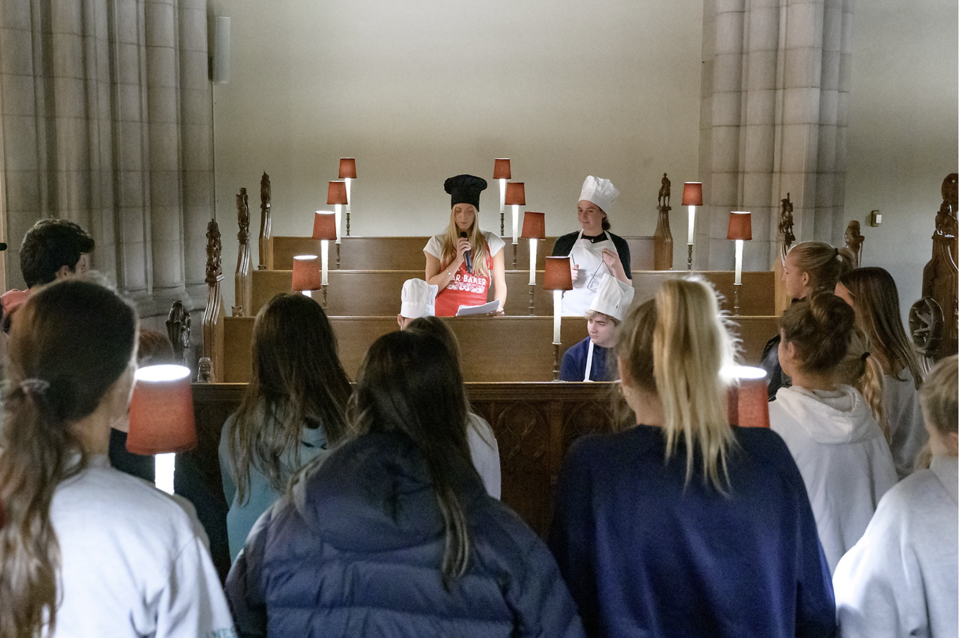
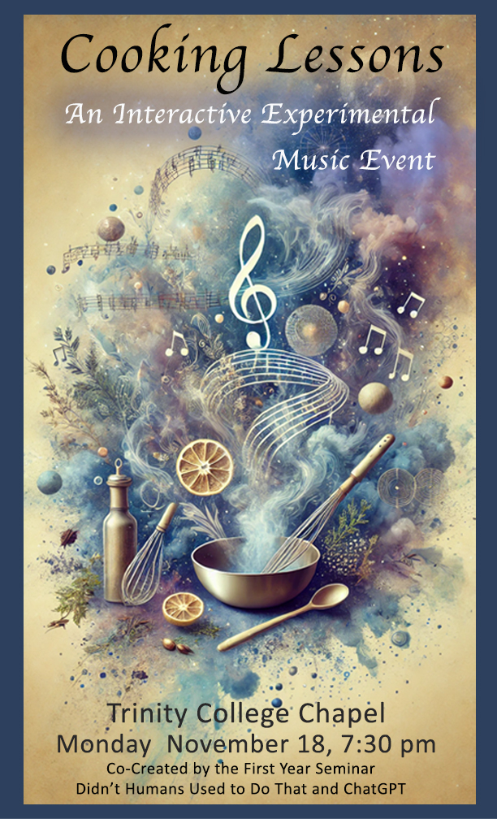
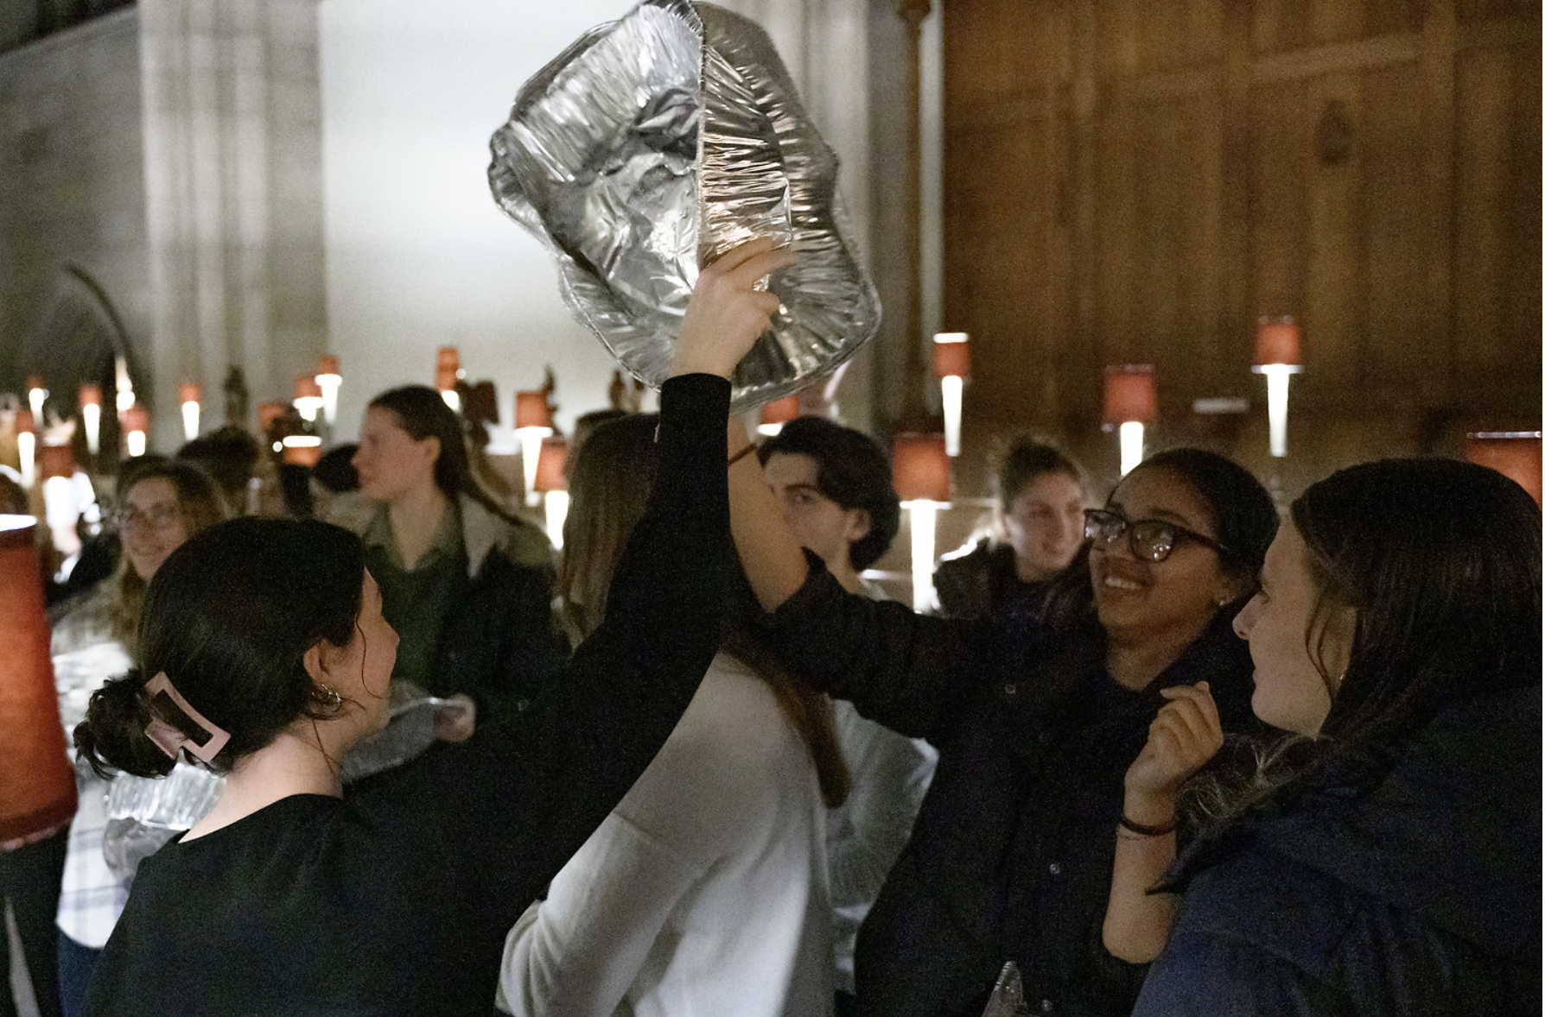
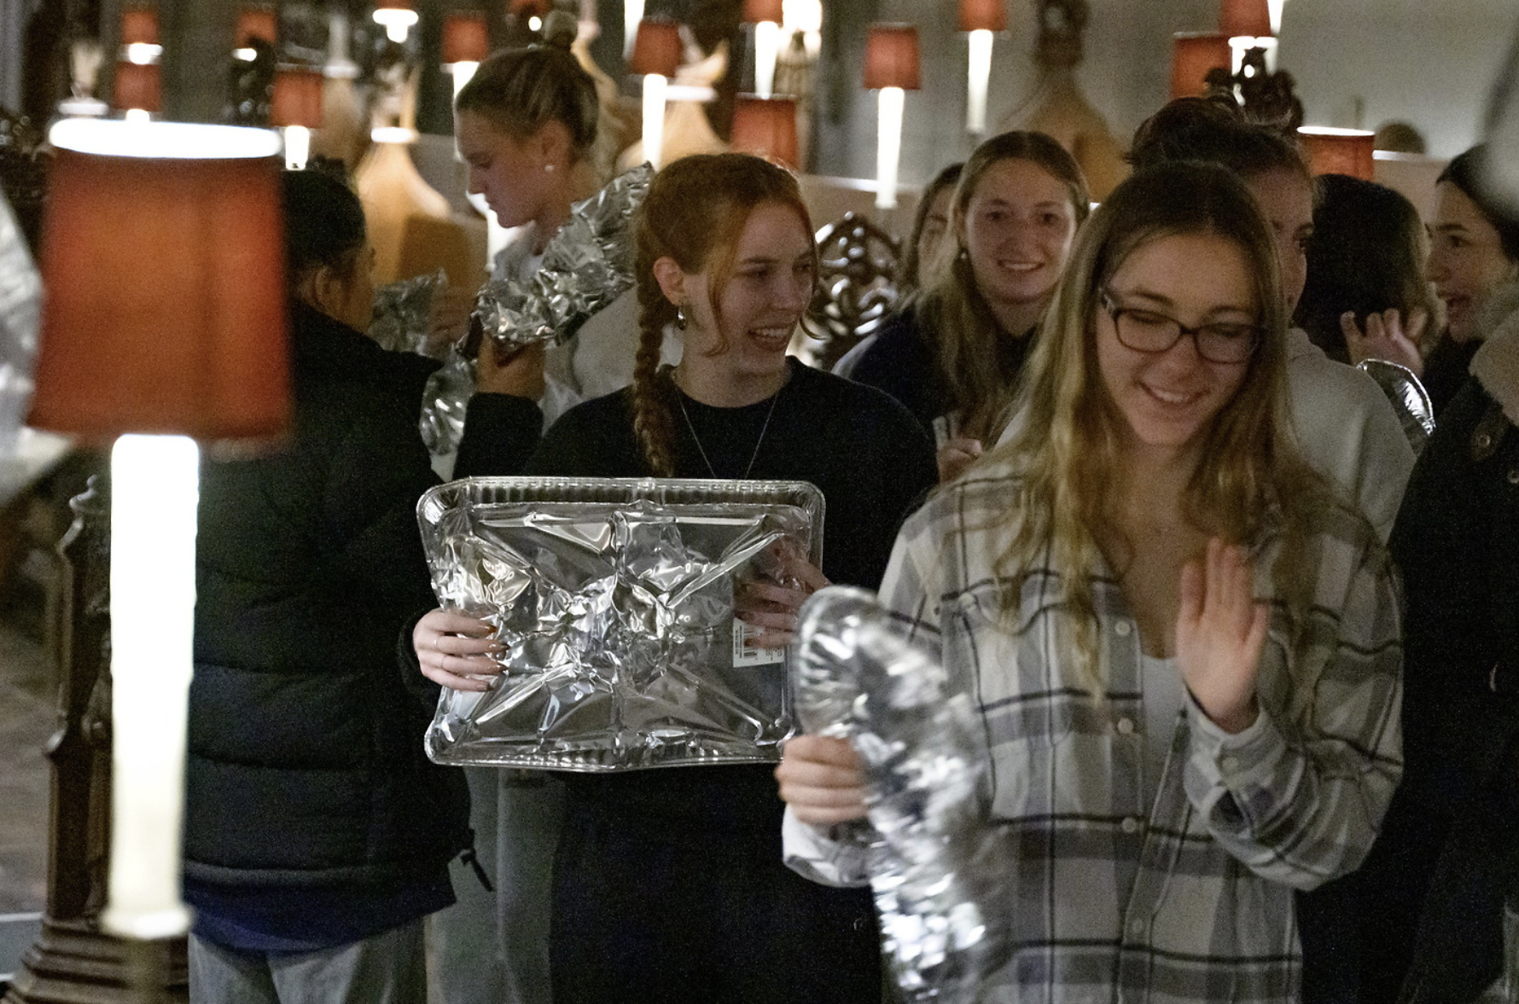
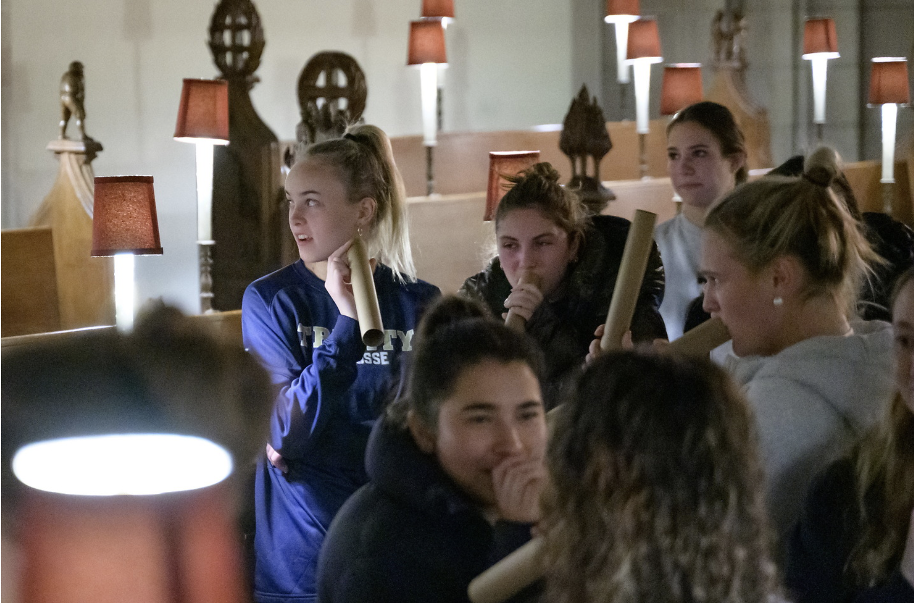
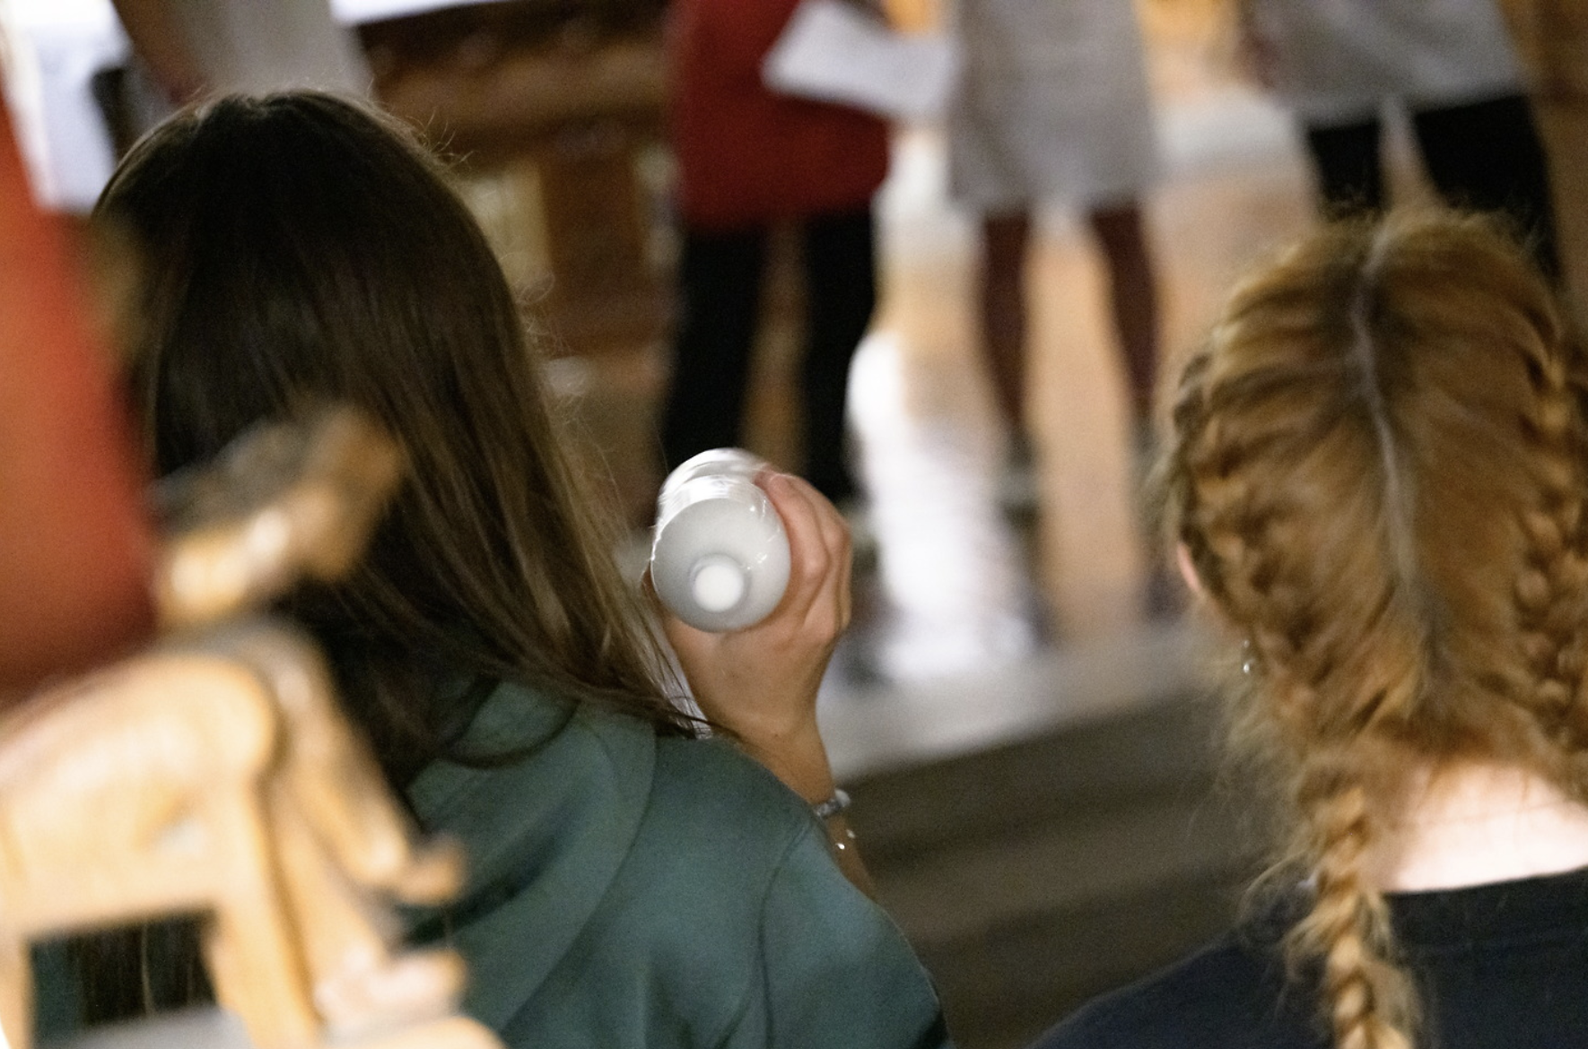

Slide 16
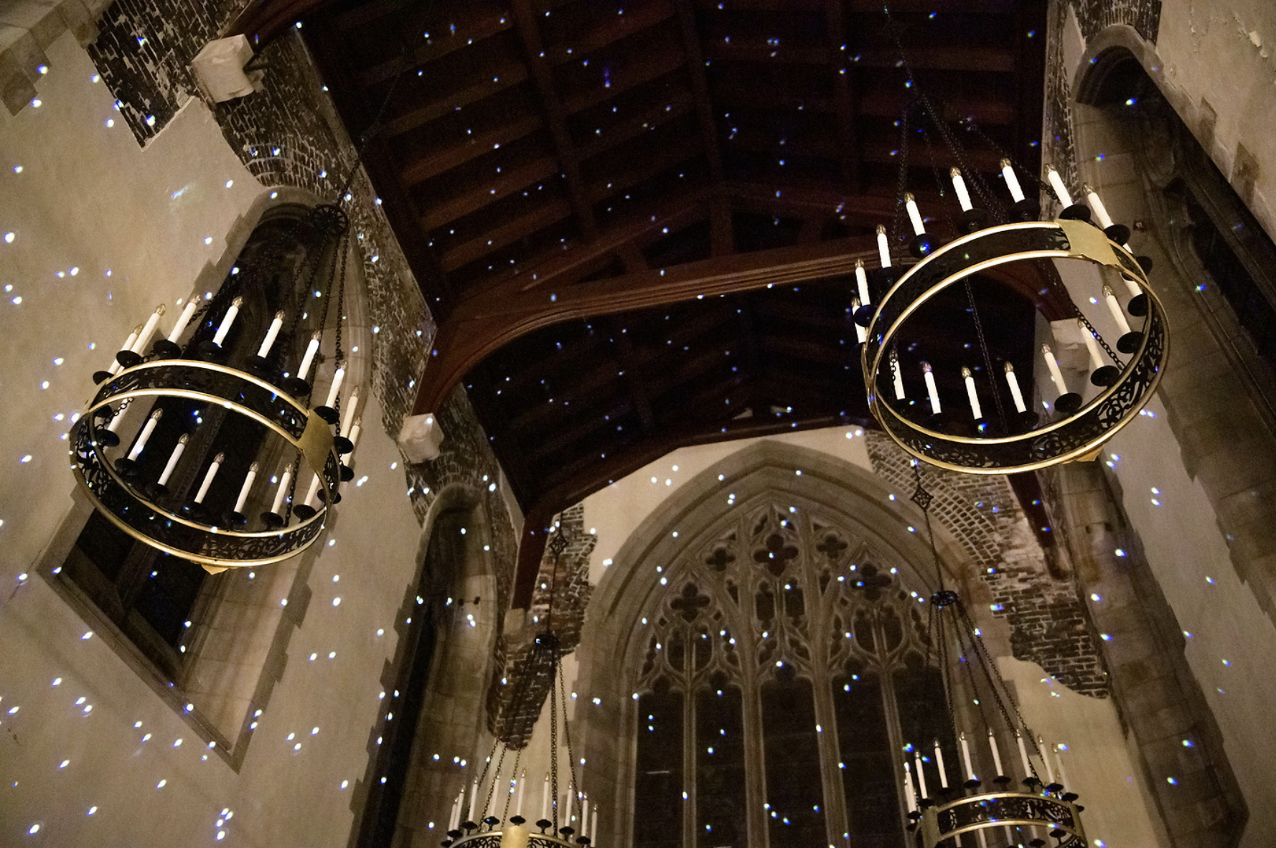

Slide 19
The Paper

Slide 20
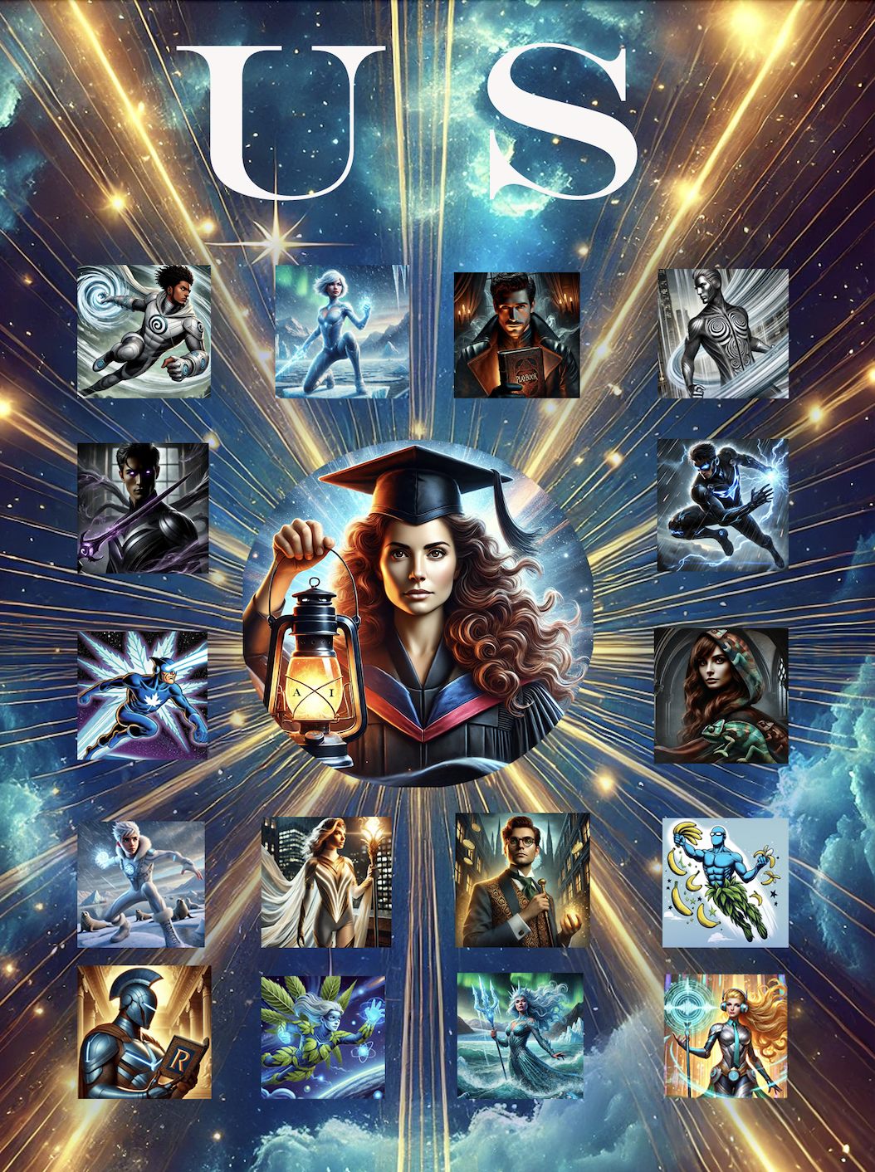

Slide 21
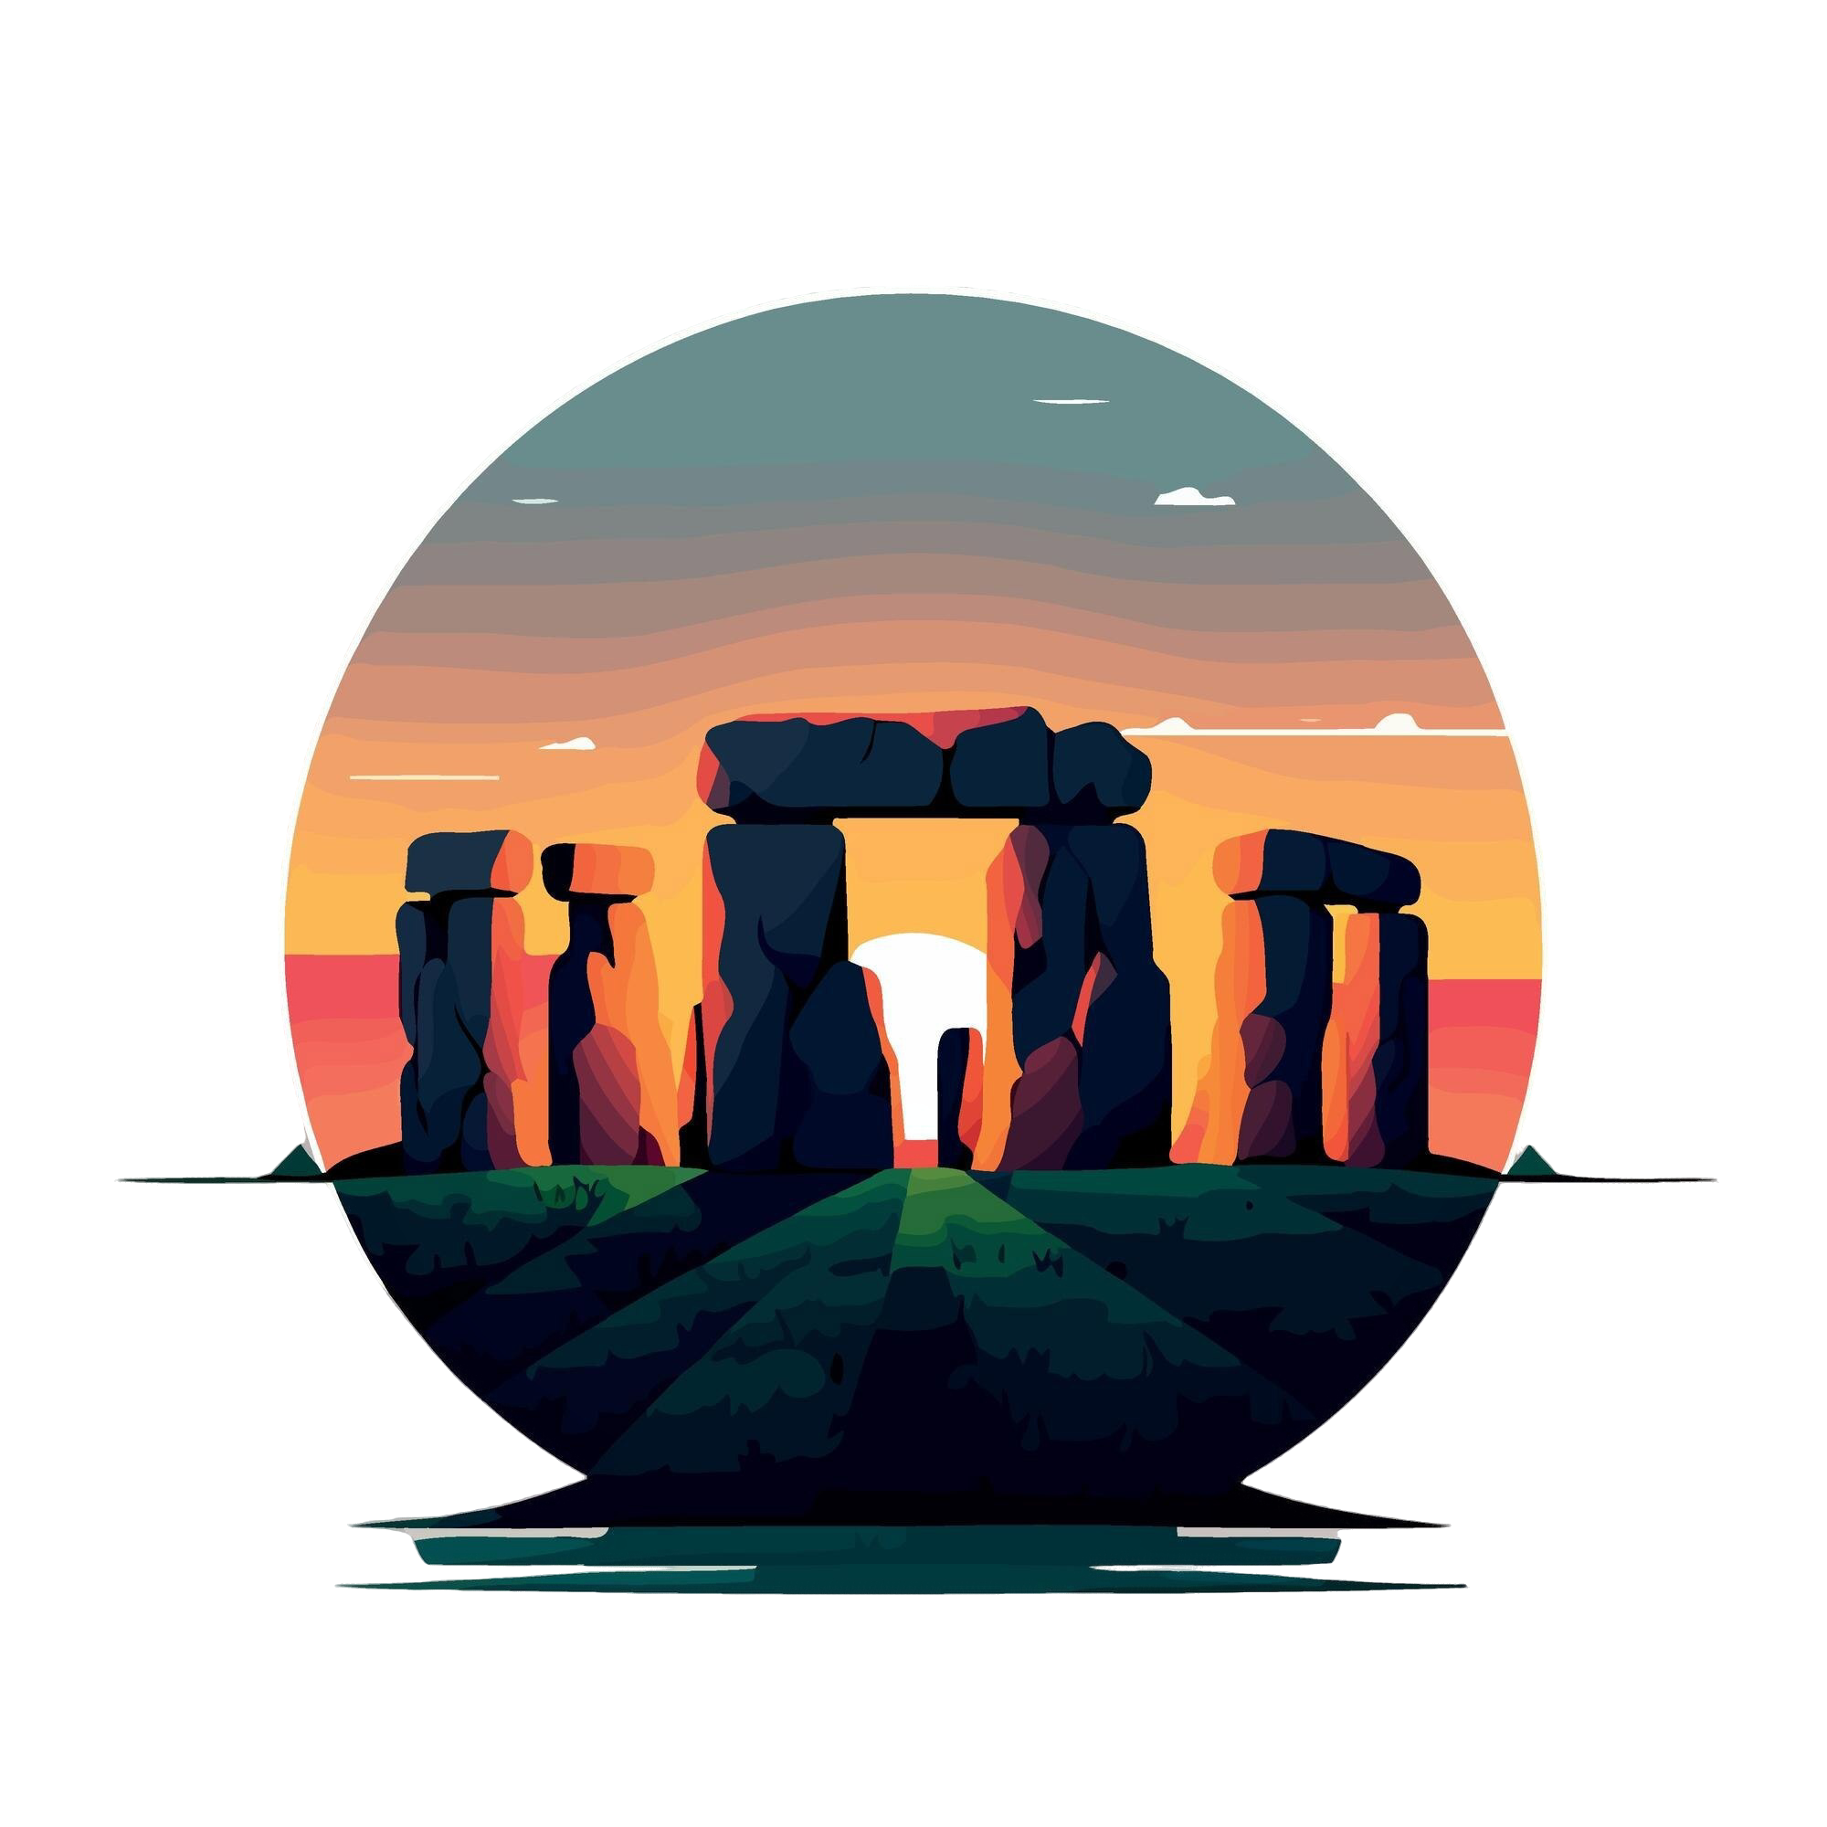
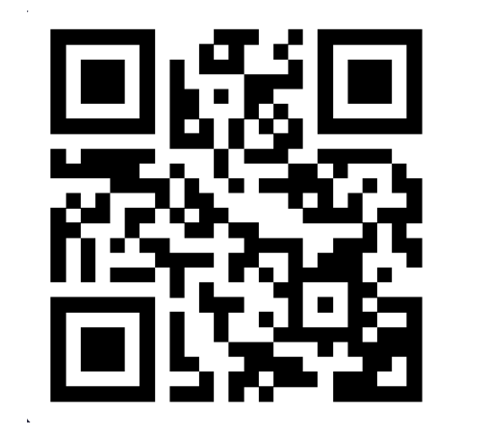
Stonehenge Dreams
A student dreams of ancient stone,
Where whispers of the past are sown.
One day they’ll roam beneath the sky,
Where towering stones and secrets lie.
For now, they study, but soon they’ll stand,
At Stonehenge’s heart, in a timeless land.
Zangmu Lama Sherpa and ChatGPT

