Slide 1


AI
Ethical Consequences of Using A.I. Tools – Impacts on Environment and Labor
Danny Pina, David Stedt, Pari Chouhan

Slide 2

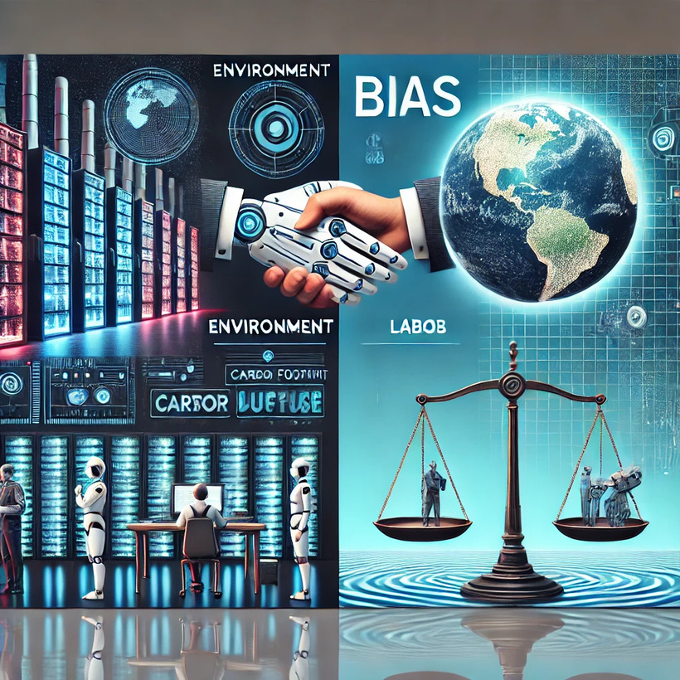

Presentation Overview
Environment: Energy consumption, Carbon footprint, Water usage
Labor: Exploitation of workers, Erosion of worker autonomy, Bias and discrimination

Slide 3


AI
Environment

Slide 4

Energy Consumption
  Unsustainable Growth: Profound Energy Demands
  AI and Global Climate Inequality
  Short -Term Gains vs. Long-Term Costs
  Challenges in Energy Transition

Slide 5
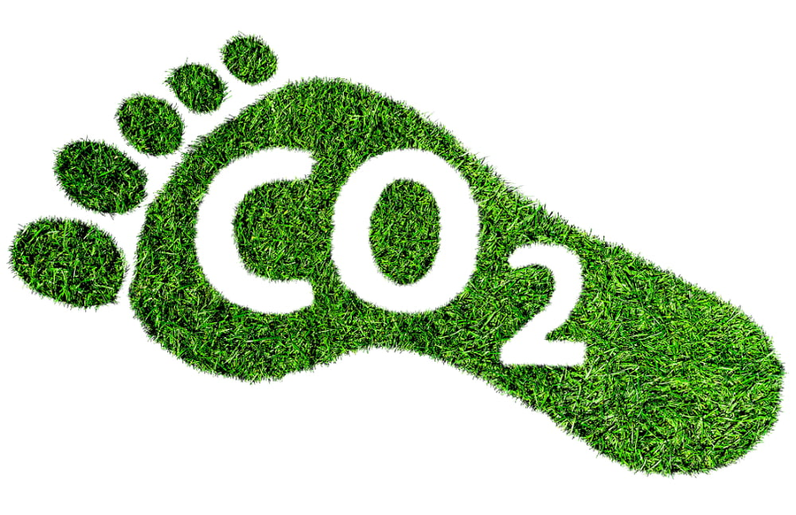
AI’s Positives
  Benefits marginalized communities
  Automatic Speech Recognition (ASR)
  Task-specific performance gains
“Improved ASR has many beneficial applications, including automatic captioning which has the potential to be beneficial for Deaf and hard of hearing people, providing access to otherwise inaccessible audio content” (Bender, et al.).

Slide 6

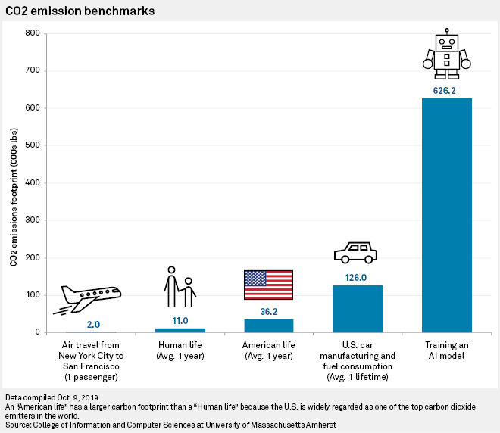
The Negative Environmental Impact
  300,000x increase in computational needs
  Most energy used in data centers comes from non-renewable sources
“Training a single BERT base model on GPUs was estimated to require as much energy as a trans-American flight” (Bender, et al.).”

Slide 7

AI's Thirst: A Hidden Environmental Cost
  The rapid growth of AI brings a hidden environmental cost: a massive water footprint.
  Water consumption occurs in two main ways:
    Scope-1 On-site: Cooling data centers, especially for energy-intensive AI tasks.
    Scope-2 Off-site: Generating the electricity to power AI, often from water-intensive sources.
  Scope-3 Embodied Water: Water use throughout the AI supply chain, like chip manufacturing. This is often under-reported.

Slide 8

The Scale of AI's Water Usage
  Google's data centers consumed nearly 20 billion liters of potable water in 2022, a 20% increase from 2021.
  Microsoft's total water usage increased 34% in the same period, likely driven by growing AI demand.
  Global AI demand may require 4.2 - 6.6 billion cubic meters of water withdrawal in 2027.910 This is
    More than the total annual water withdrawal of 4-6 Denmarks.
    Half of the United Kingdom's annual water withdrawal.
  If the U.S. hosts half of global AI workloads, this could take up 0.5 - 0.7% of its total annual water withdrawal.

Slide 9
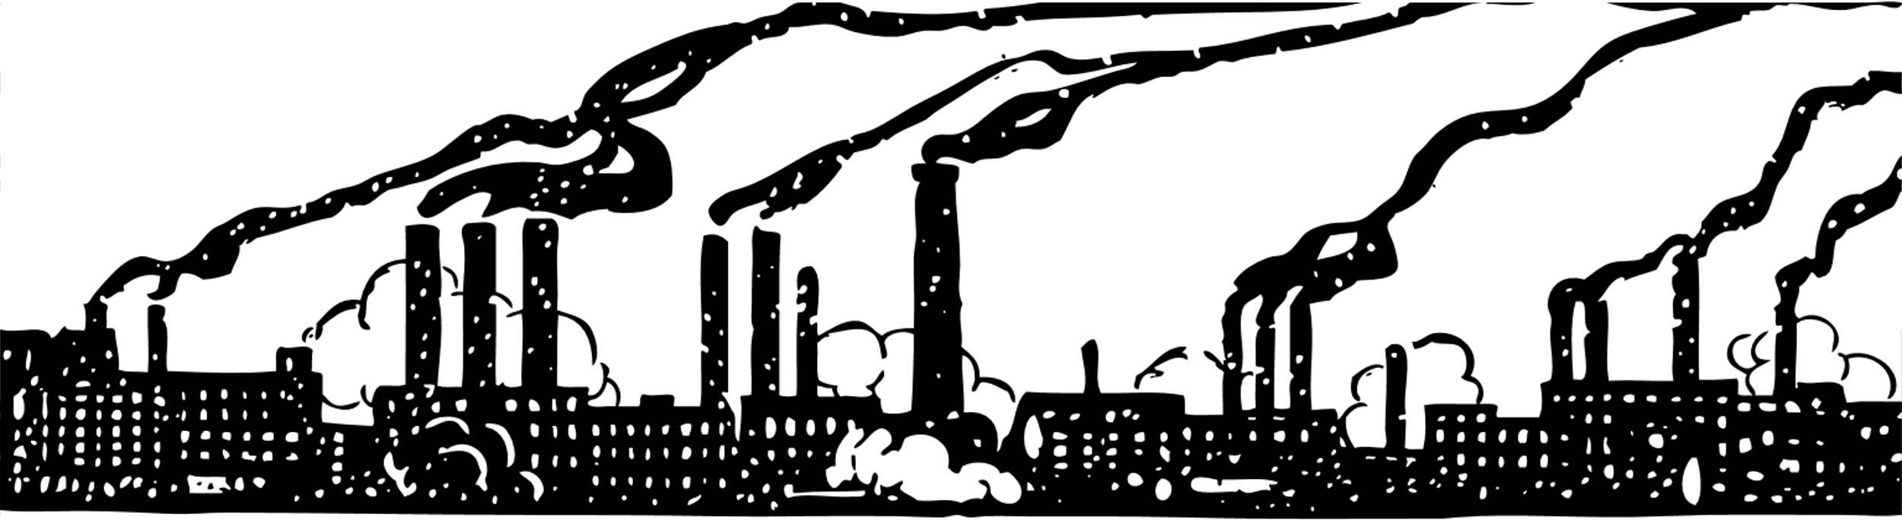
Taking Action: Reducing AI's Water Footprint
What Corporations and Companies Can Do:
    Transparency is key.
    "Unfollow the Sun."
    Optimize "When" and "Where.

Slide 10

Taking Action: Reducing AI's Water Footprint
What Students and Professors Can Do:
    Advocate for Transparency
    Promote Water-Conscious AI Practices.
    Consider Environmental Costs Upfront.
    Engage in Interdisciplinary Dialogue.

Slide 11

AI
Labor

Slide 12

The Hidden Human Cost of AI
  AI systems are often portrayed as autonomous, but they rely heavily on human labor.
  This labor is often hidden and undervalued, taking many forms:
    Data labeling and annotation to train algorithms
    Content moderation and clarification when AI encounters errors
    Monitoring and quality control of AI outputs
  This work is often outsourced to low-wage countries, leading to exploitation.

Slide 13

Ethical Implications and Impacts of AI-Driven Labor Exploitation
  Economic Injustice
  Erosion of Labor Rights
  Reinforcement of Global Inequalities
  Opacity and Lack of Accountability
  Undermining of Human Dignity

Slide 14

Erosion of Worker Autonomy
  “Profit Over People”
  Dehumanization of Work
  Unchecked Bias and Exploitation
  Psychological Impact on Workers

Slide 15
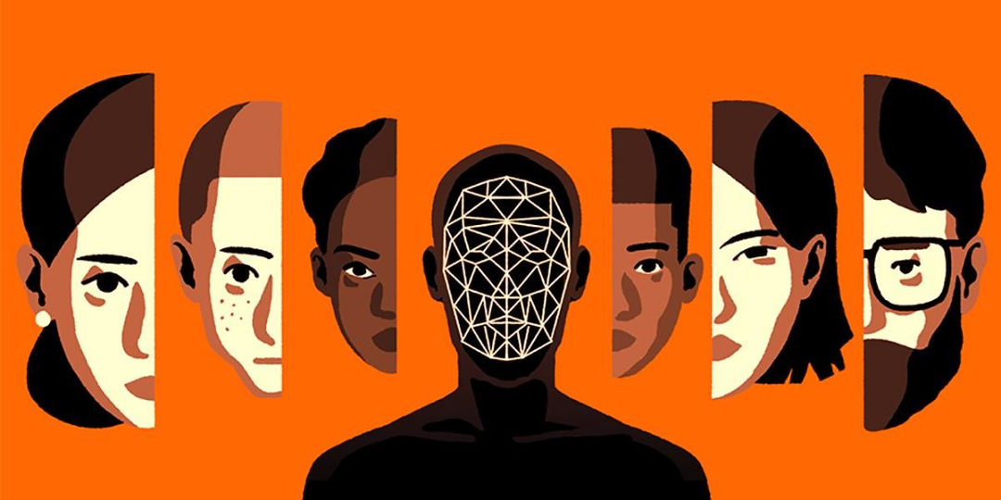
AI’s Bias & Discrimination
  White Mainstream English
  Erasure of diverse perspectives
  Reinforcing stereotypes
“The language reified by GenAI is the language of White Mainstream English. The training sets used to develop GenAI platforms primarily consist of internetbased language developed by mostly younger and mostly white writers” (Sweetland).

Slide 16
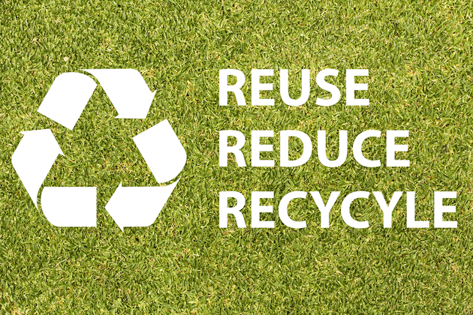
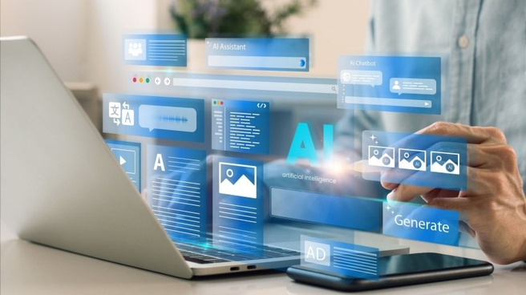
What You Should Do!
Minimize Unnecessary Usage
Leverage Greener AI Platforms
Advocate for Policy Changes
Integrate Environmental AI Literacy into Curriculum

Slide 17
Works Cited
Bender, Emily M., et al. “On the Dangers of Stochastic Parrots.” Proceedings of the 2021 ACM Conference on Fairness, Accountability, and Transparency, Mar. 2021, pp. 610–623, https://doi.org/10.1145/3442188.3445922.
“Linguistic Justice and GenAI: U-M LSA Sweetland Center for Writing.” LSA, lsa.umich.edu/sweetland/instructors/guides-to-teaching-writing/linguistic-justice-genai.html. Accessed 15 Jan. 2025.
Evanick, Joseph, Ed.D. “Integrating AI in Curriculum Design: A Comprehensive Guide for Educators.” eLearning Industry, 28 June 2024, elearningindustry.com/integrating-ai-in-curriculum-design-a-comprehensive-guide-for-educators.
Ibbotson, Kate. “Easy Ways to Reduce Consumption - A Tidy Mind.” Professional Decluttering and Organising Service, 18 Oct. 2024, www.atidymind.co.uk/easy-ways-to-simplify-your-life-and-reduce-consumption/.
Malhotra, Sahil. “Understanding and Addressing Bias in Artificial Intelligence.” LinkedIn, 16 Sept. 2023, www.linkedin.com/pulse/understanding-addressing-bias-artificial-intelligence-sahil-malhotra/.
Qureshi, Annie. “What Is Your Carbon Footprint and How Can You Reduce It?” Blue and Green Tomorrow, 4 Aug. 2022, blueandgreentomorrow.com/environment/what-is-carbon-footprint-and-how-can-you-reduce-it/.
Rasay, Stefen Joshua, and Taimoor Tariq. “AI’s Large Carbon Footprint Poses Risks for Big Tech.” S&P Global Homepage, 17 Oct. 2019, www.spglobal.com/marketintelligence/en/news-insights/latest-news-headlines/ai-s-large-carbon-footprint-poses-risks-for-big-tech-54710079

Slide 18
Works Cited
Dzieza, Josh. “Inside the AI Factory.” Intelligencer, Intelligencer, 20 June 2023, nymag.com/intelligencer/article/ai-artificial-intelligence-humans-technology-business-factory.html.
Hao, Karen. “Microsoft’s Hypocrisy on Ai.” The Atlantic, Atlantic Media Company, 13 Sept. 2024, www.theatlantic.com/technology/archive/2024/09/microsoft-ai-oil-contracts/679804/.
Lina. “Lina Khan: We Must Regulate A.I. Here’s How.” The New York Times, The New York Times, 3 May 2023, www.nytimes.com/2023/05/03/opinion/ai-lina-khan-ftc-technology.html.
Weinberg, Lindsay. “Ai Is Consolidating Corporate Power in Higher Ed (Opinion).” Inside Higher Ed | Higher Education News, Events and Jobs, 6 Nov. 2024, www.insidehighered.com/opinion/views/2024/11/06/ai-consolidating-corporate-power-higher-ed-opinion.
Rosenthal, Elisabeth. “We’re Creating an AI Energy Crisis That’s Accelerating Climate Change, Not Mitigating It.” The New York Times, 2023.
Metz, Cade. “While AI Optimization Reduces Costs, Energy Use Remains a Challenge.” MIT Technology Review, 2023.
“If We Continue Relying on Fossil Fuels to Power AI, We’re Trading Technological Innovation for the Health of Our Planet.” Greenpeace, 2023, www.greenpeace.org.

Slide 19
Works Cited
Bensinger, Greg. “Amazon’s AI Penalizes Workers for Taking Bathroom Breaks.” The Verge, 2022, www.theverge.com.
Smith, John. “When a Machine Makes Decisions about Your Job, Who Can You Turn to for Support?” Harvard Business Review, 2022.
Sample, Ian. “AI Inherits Society’s Flaws, but It’s the Workers Who Bear the Consequences.” The Guardian, 2022, www.theguardian.com.
Caldwell, David. “You’re Not Just Working for Uber—You’re Working for an Algorithm That Controls Your Life.” The Atlantic, 2023.
“AI’s Constant Monitoring Makes Workers Feel Like Robots, Not Humans.” Forbes, 2022.

Slide 20
AI
THANK YOU

